Slide 1

GEOG 4/590: Geospatial Data Science
Lecture 4: Gridded data analysis
Email: jryan4@uoregon.edu
Office: 163A Condon Hall
Office hours: Mondays 14:00-16:00

Slide 2
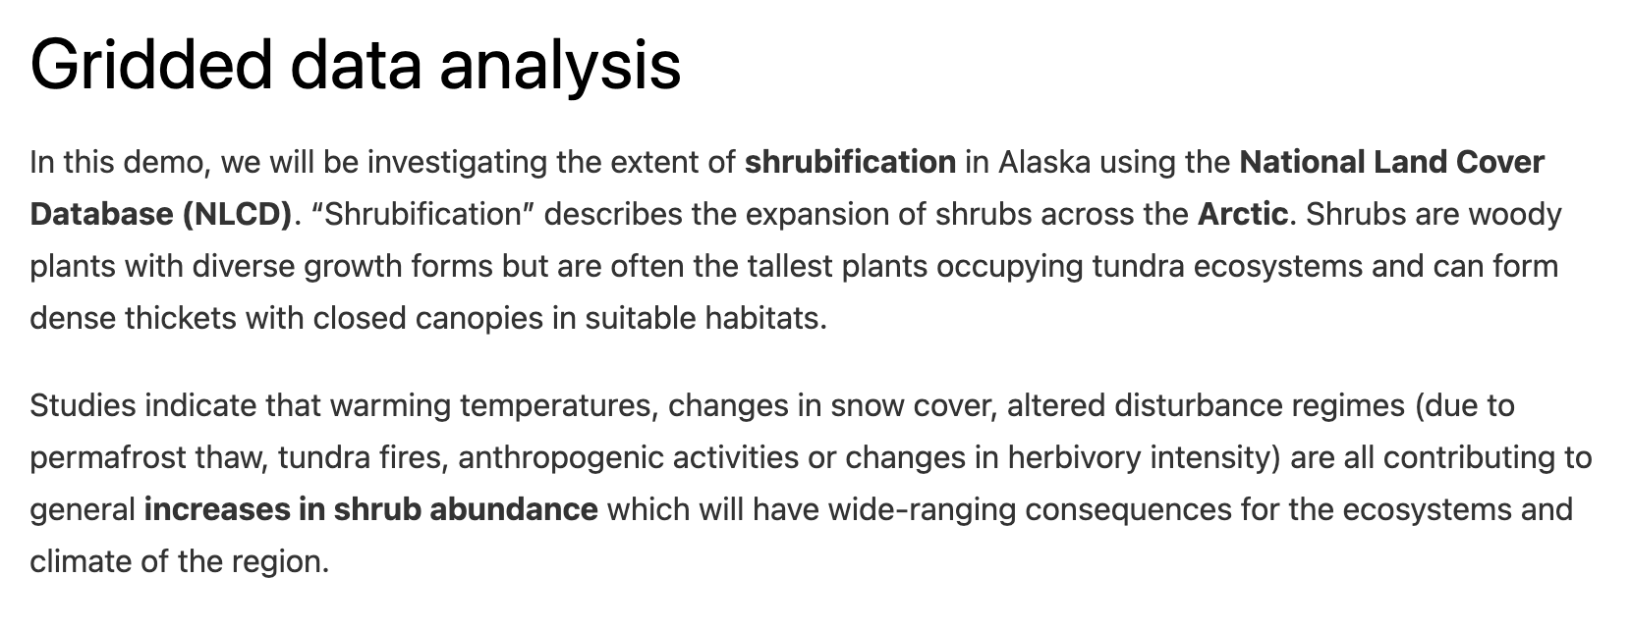
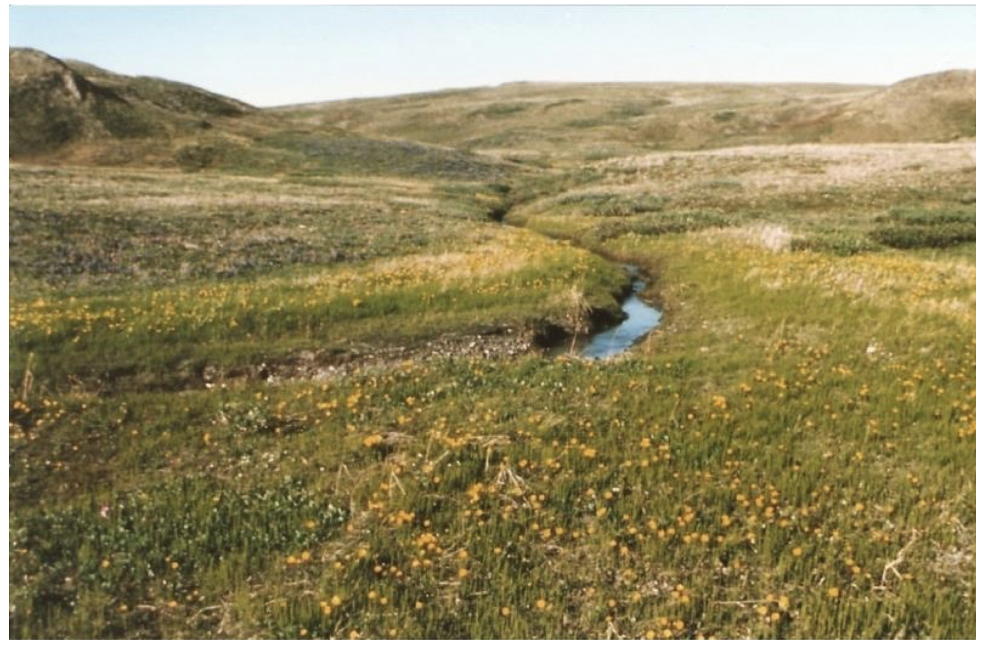
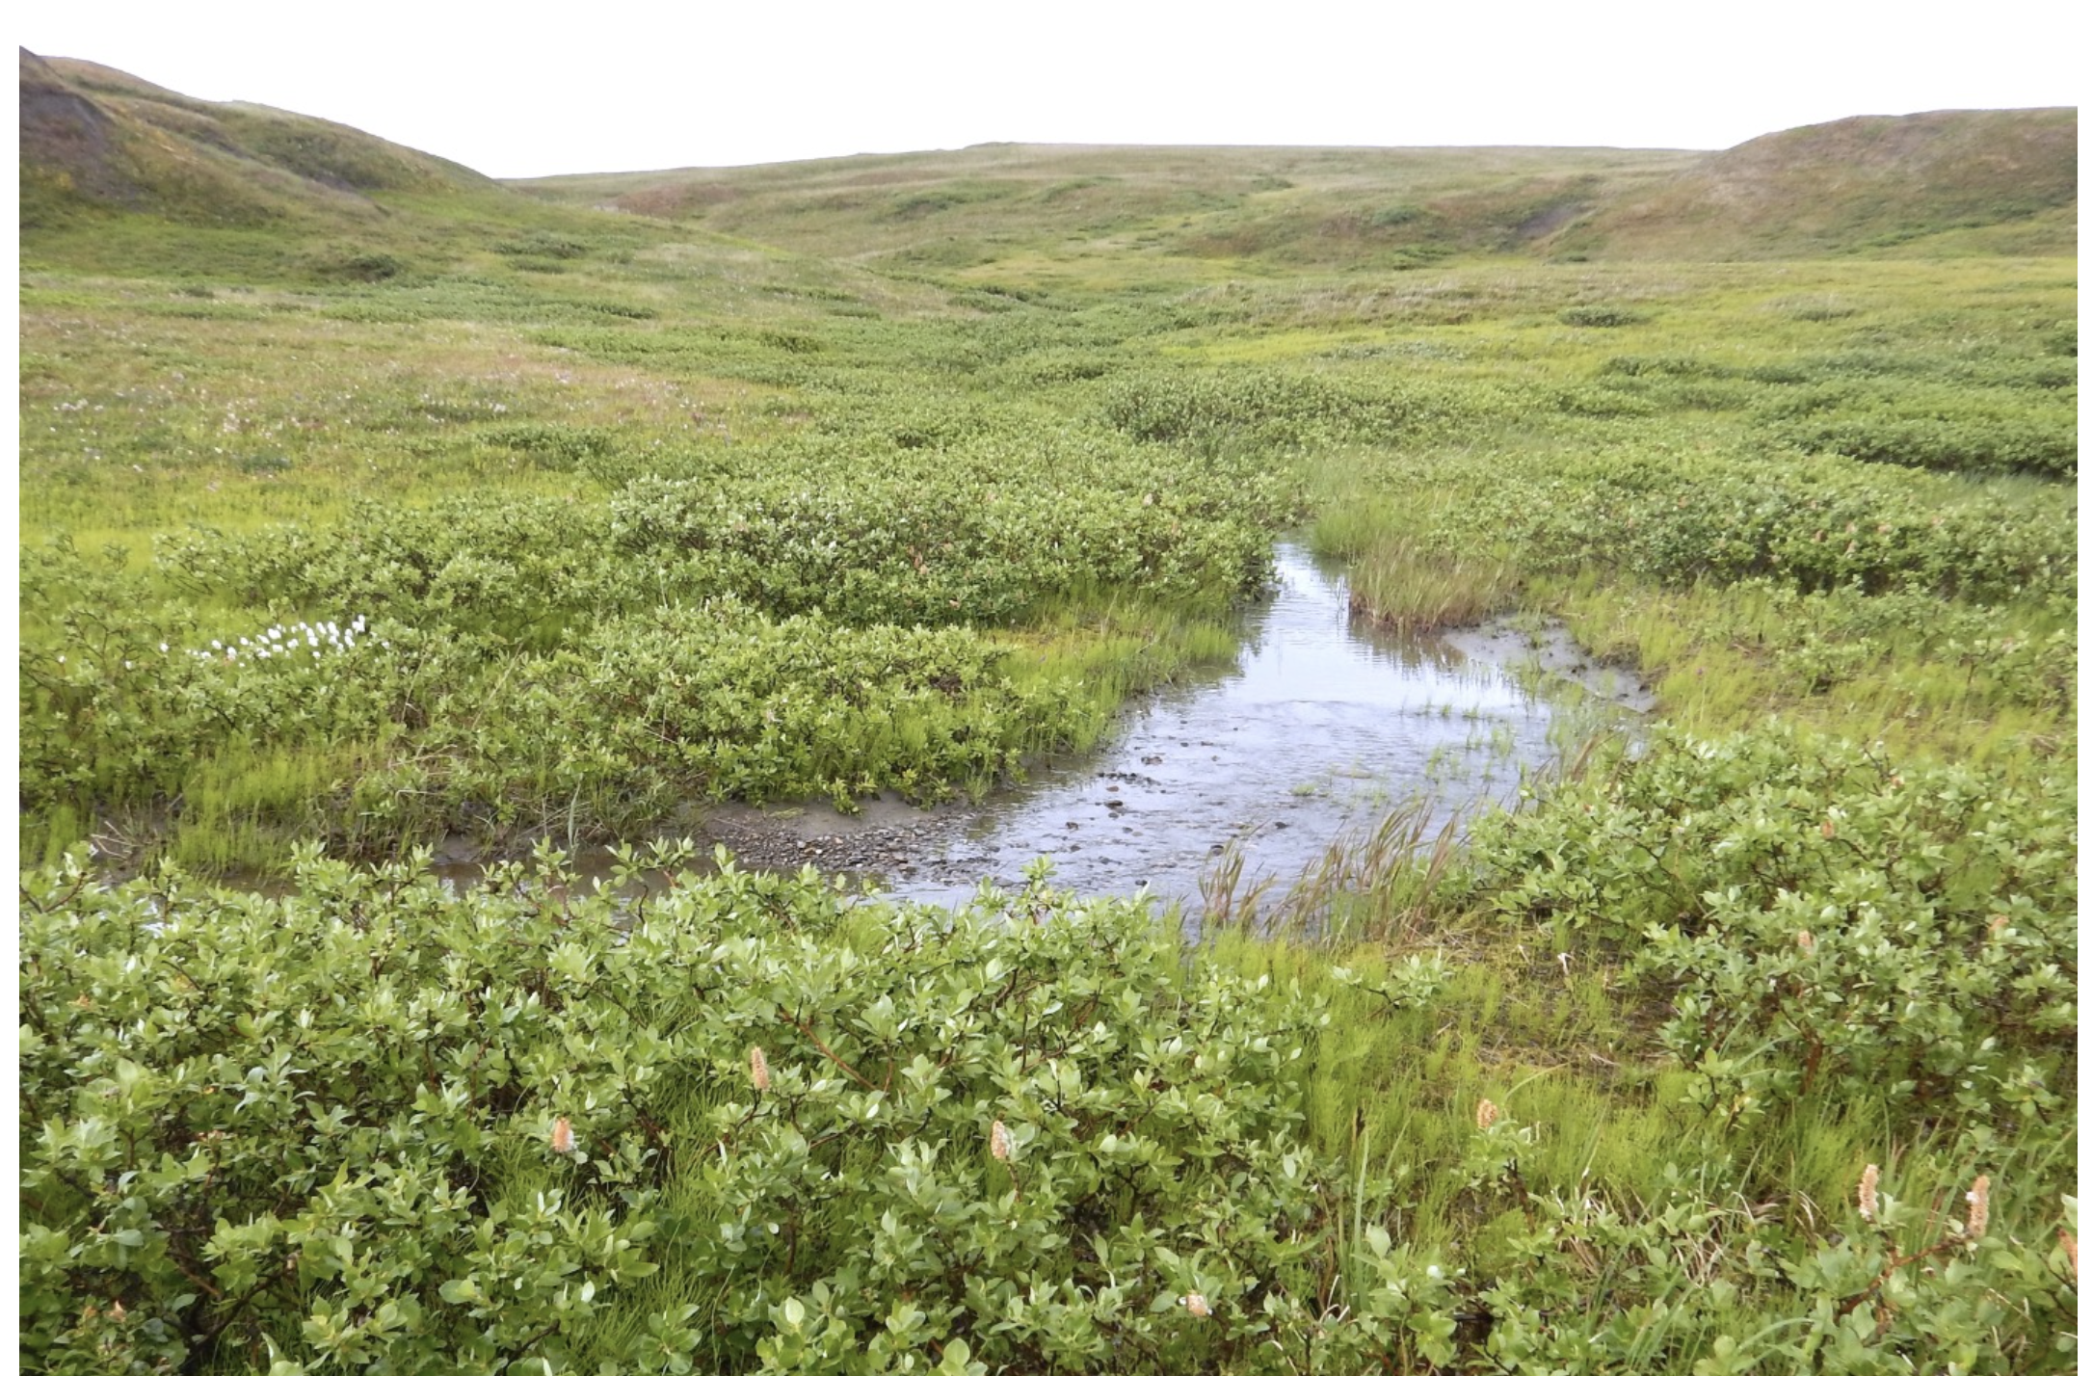
Notes:
The left photo was taken in 1987 and the right in 2017. Replacement of grasses with shrubs.

Slide 3
Notes:
Winners and losers – longer growing season might be good for birds but shrubs provide less nutrients for reindeer than grass.

Slide 4
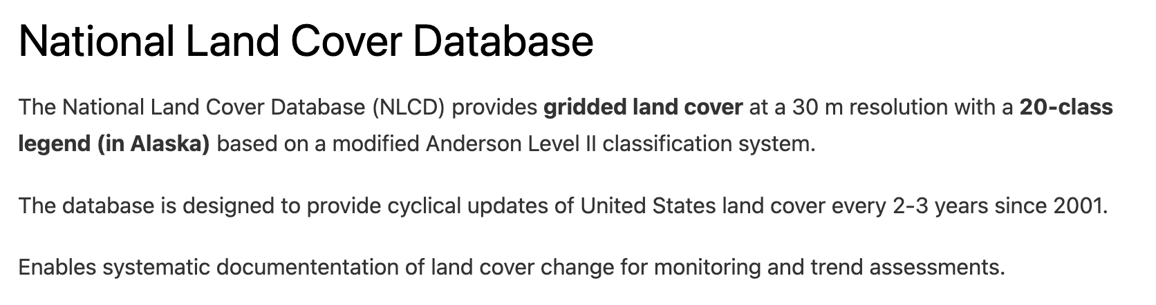
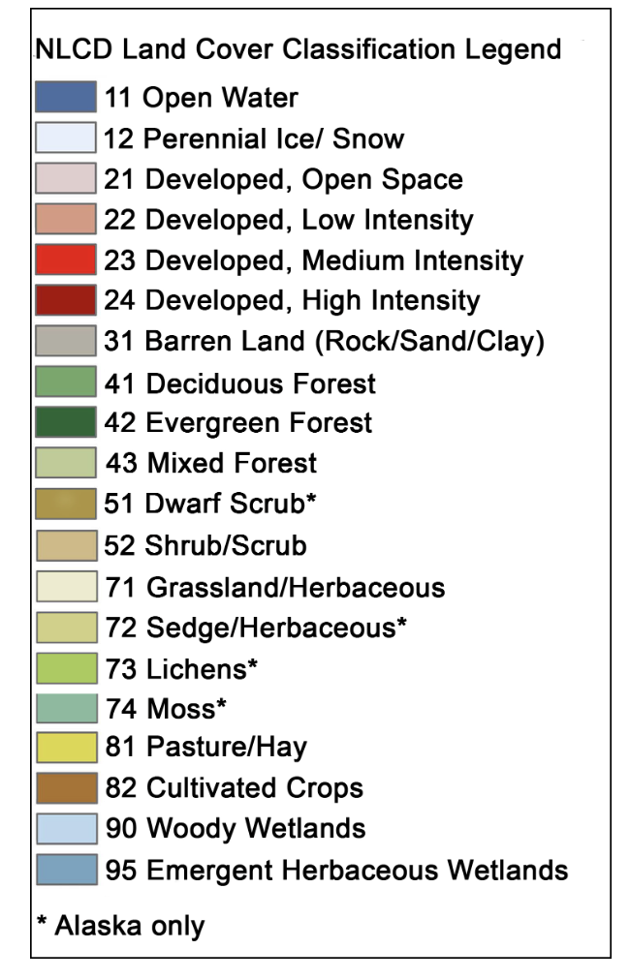
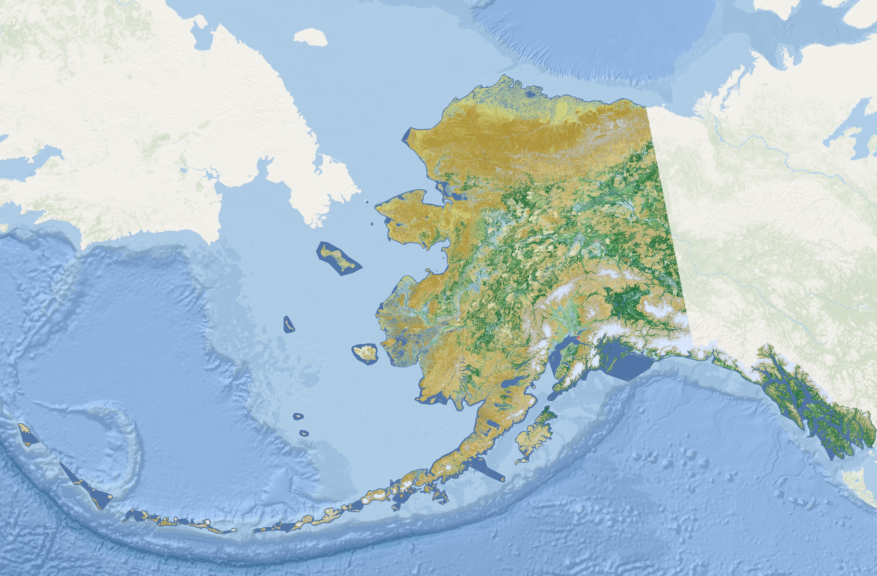

Slide 5
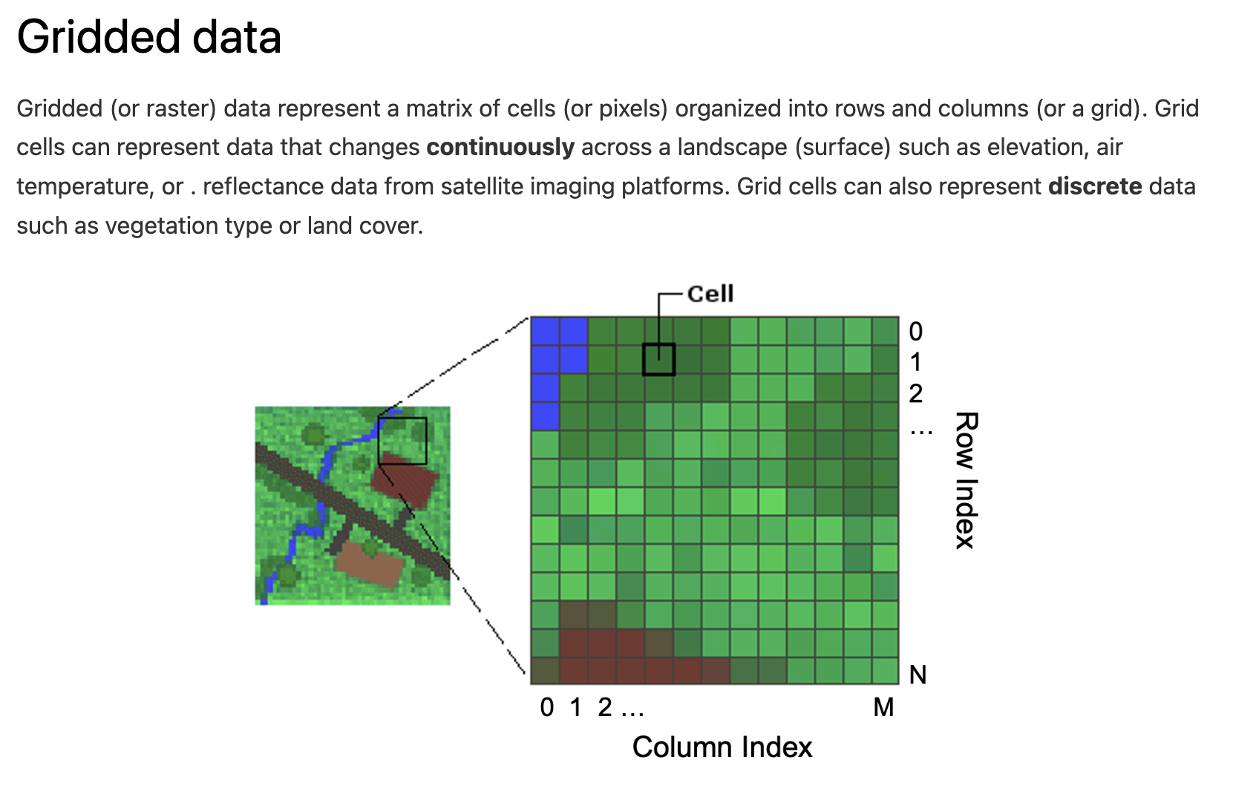

Slide 6
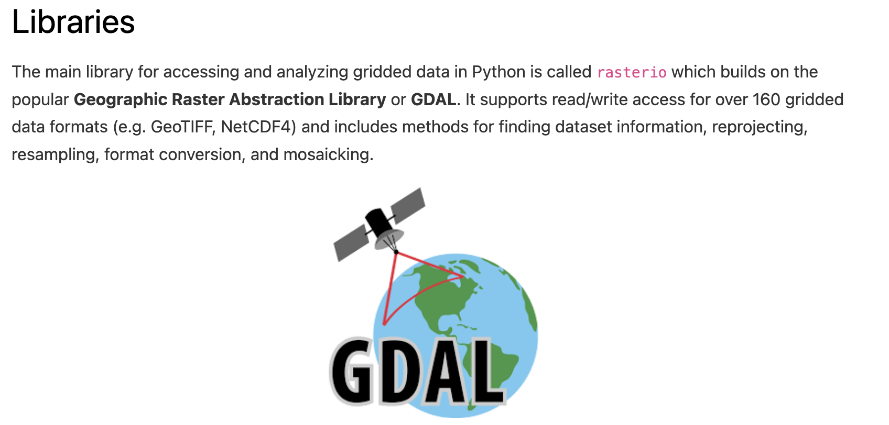

Slide 7
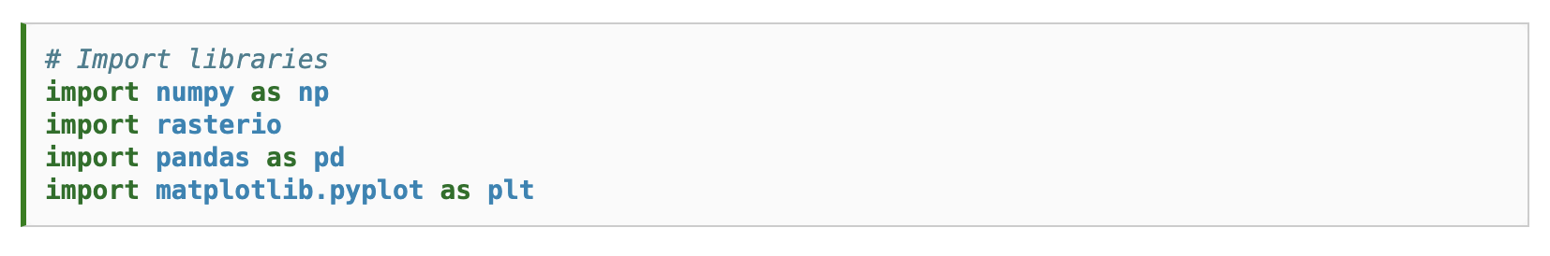

Slide 8
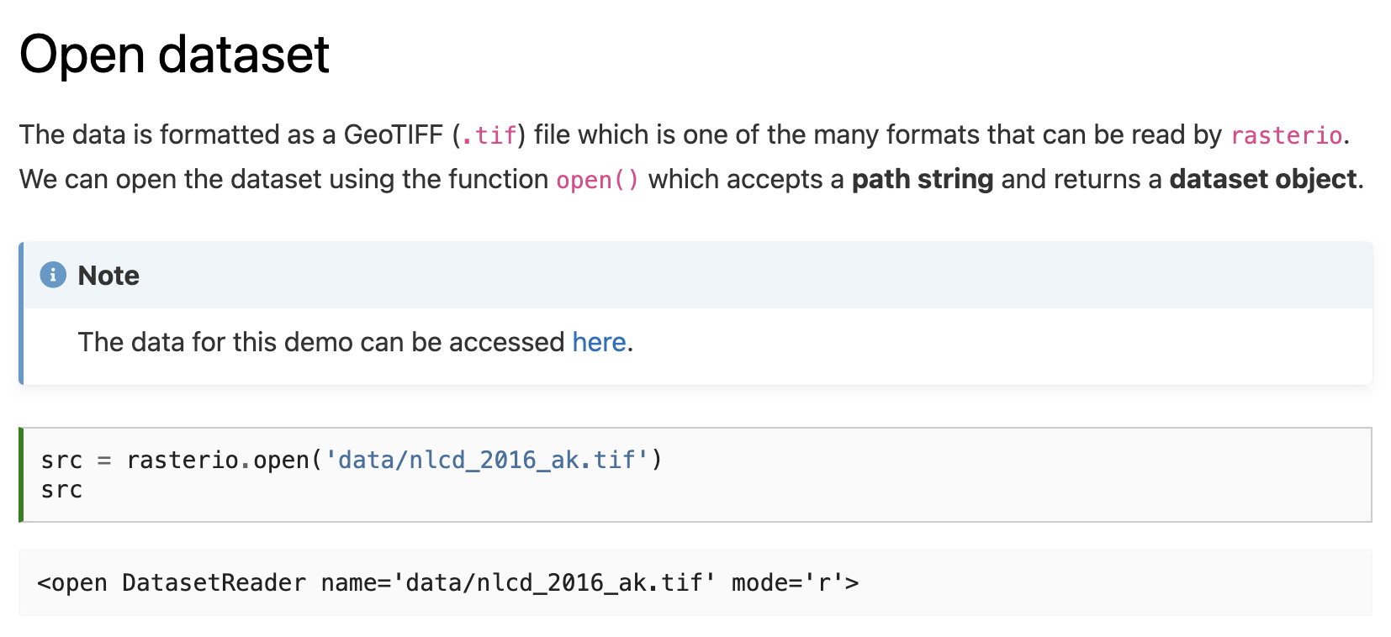

Slide 9
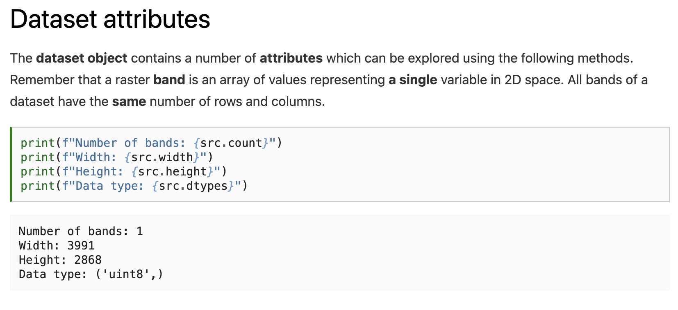
Notes:
How many different values can be stored in an uint8?

Slide 10
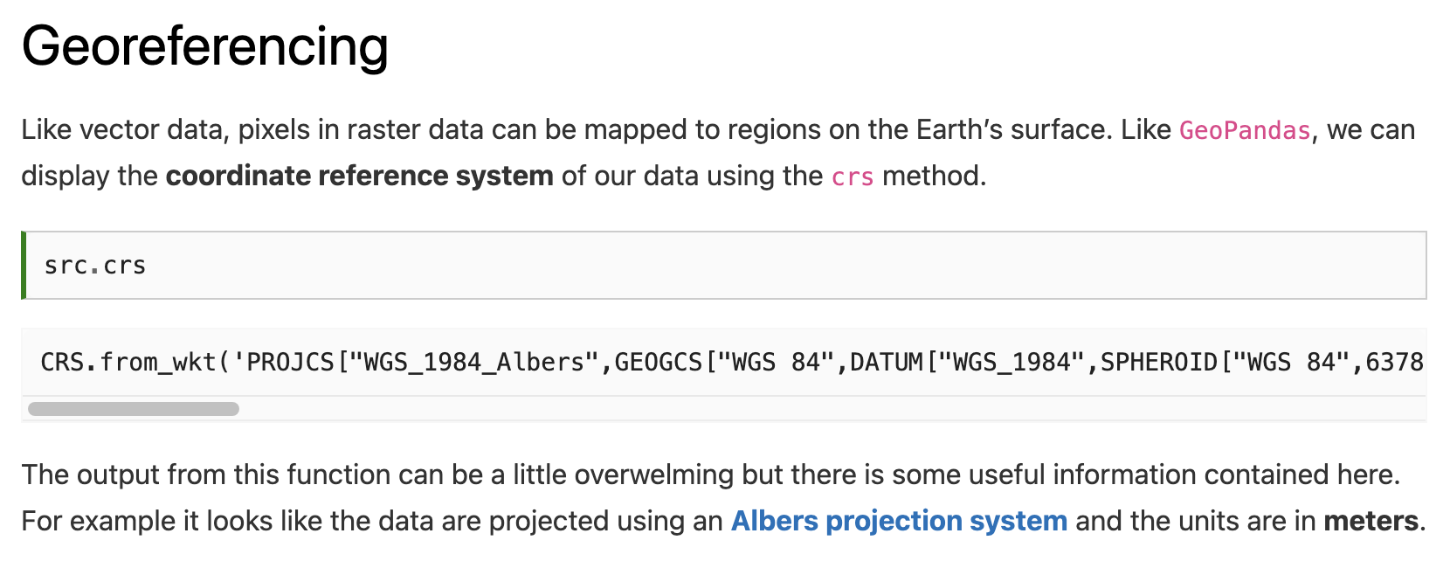

Slide 11
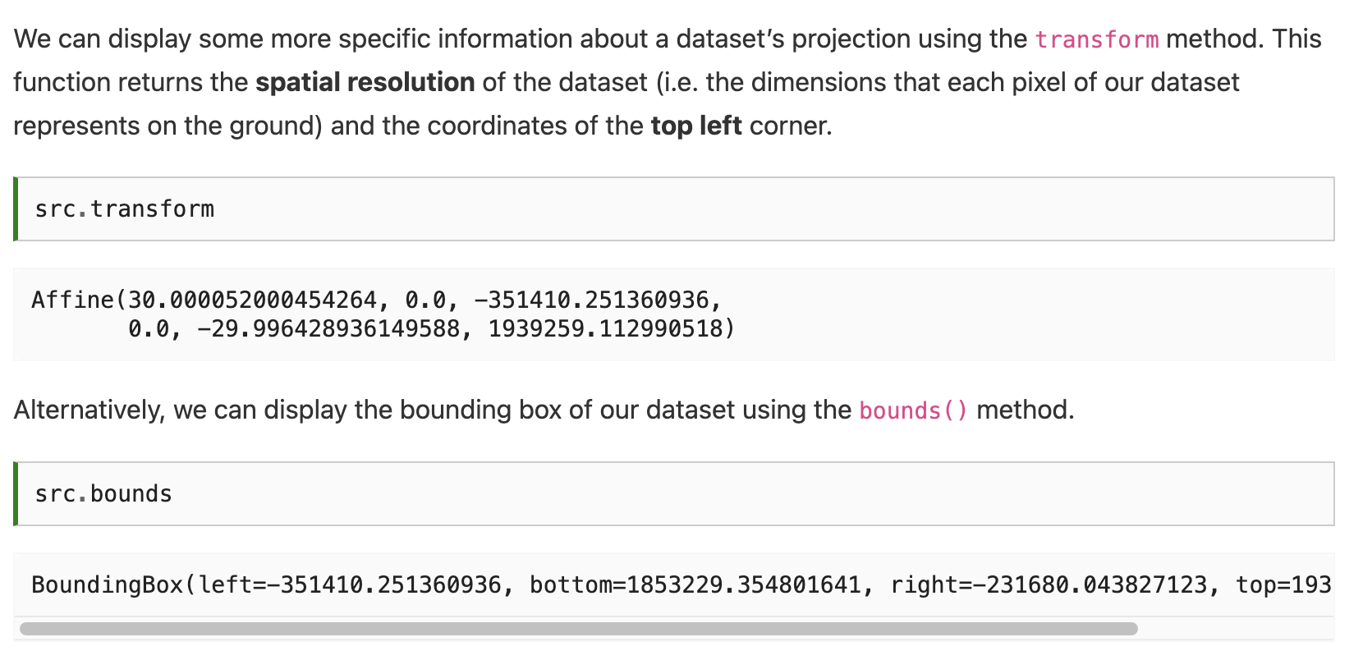

Slide 13
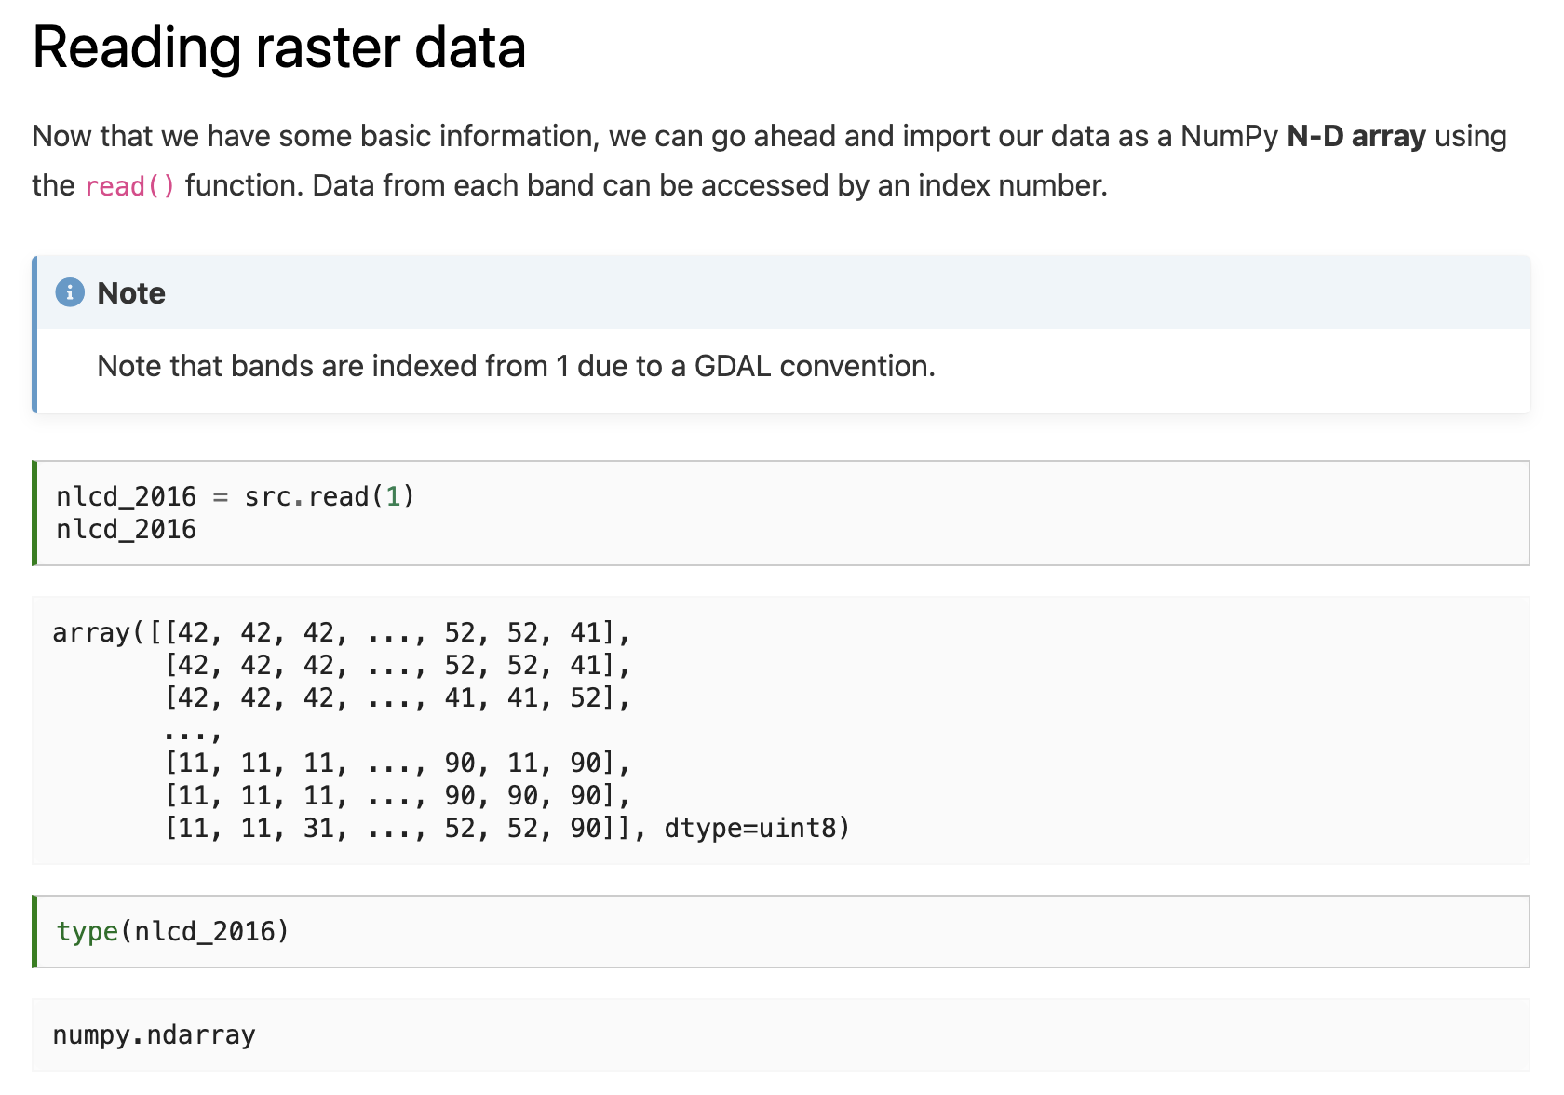

Slide 15
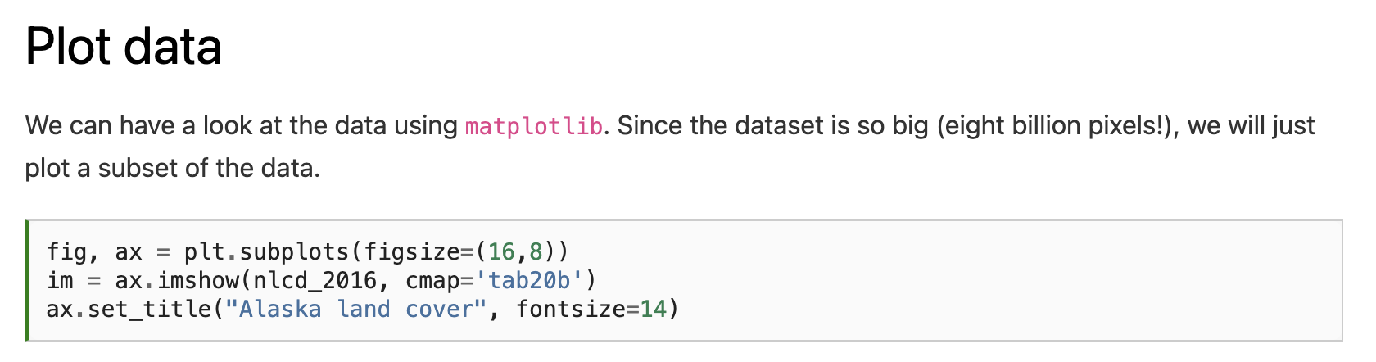
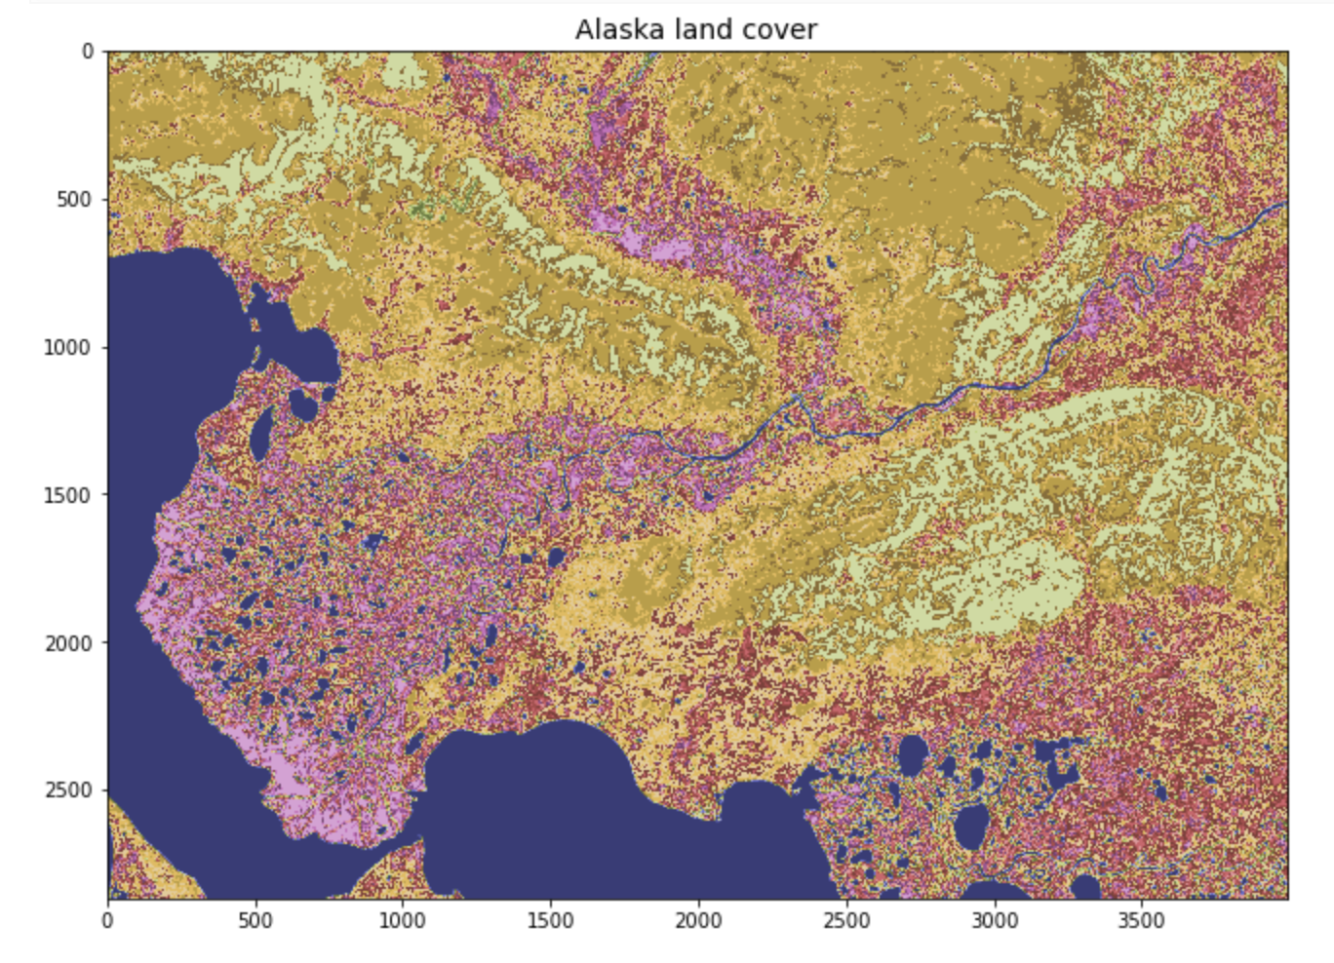

Slide 16
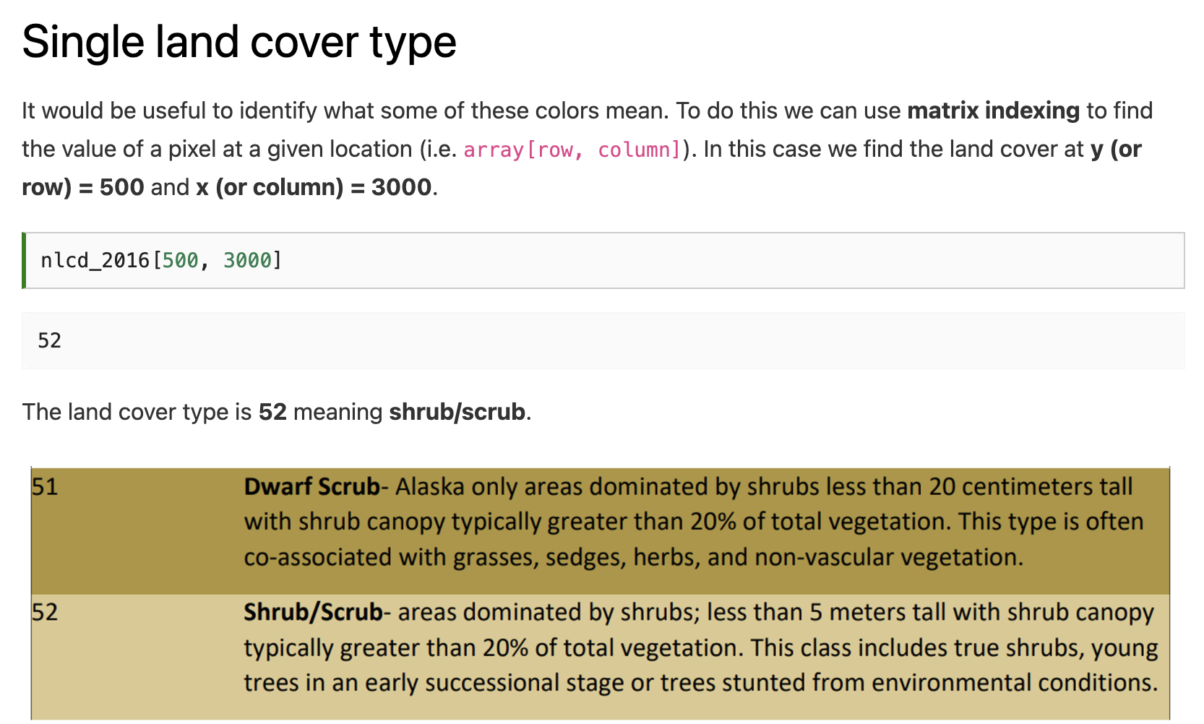

Slide 18
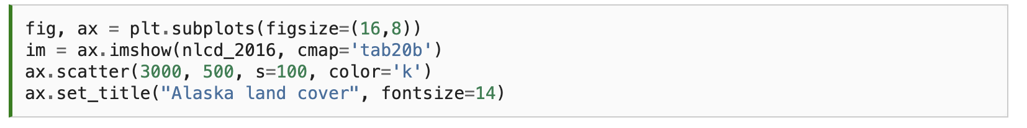
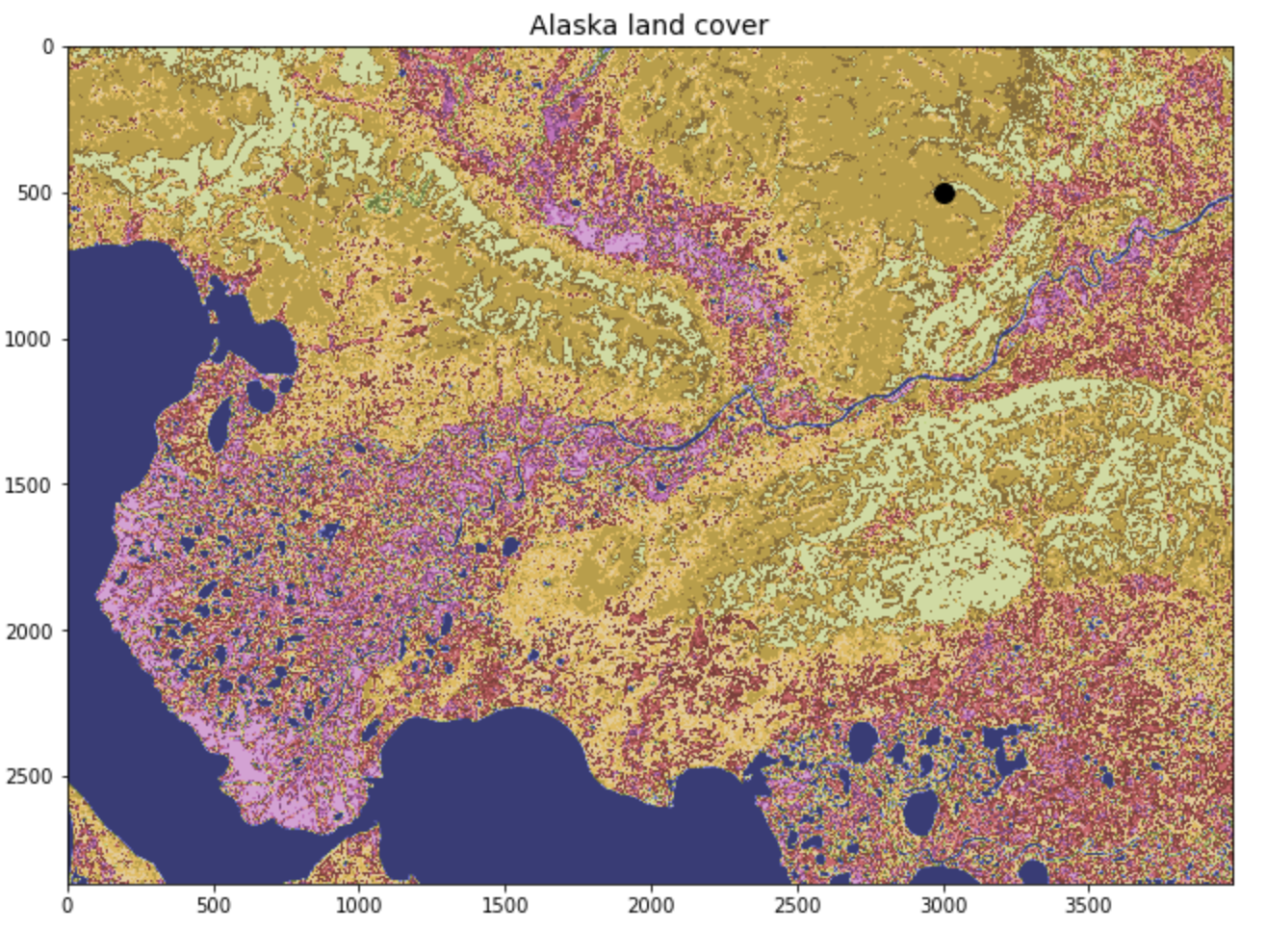

Slide 19
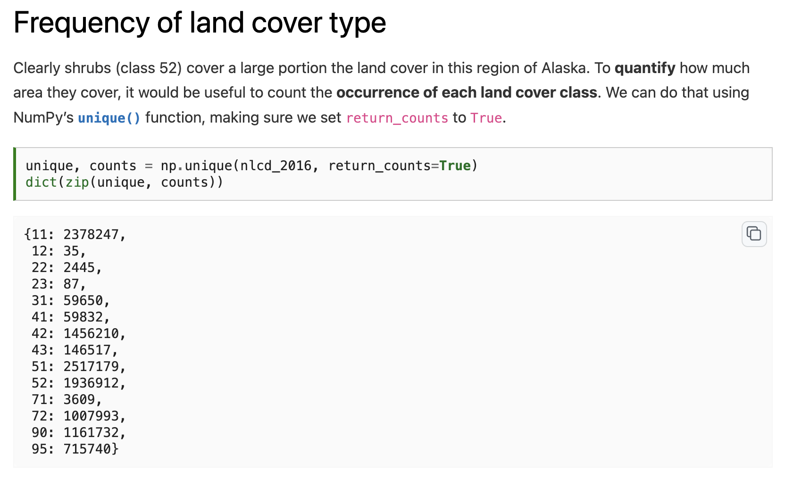

Slide 20
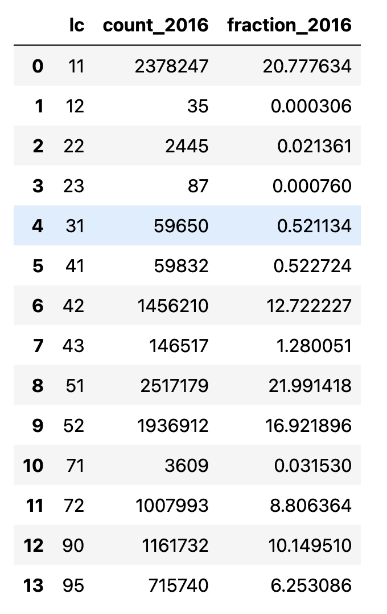
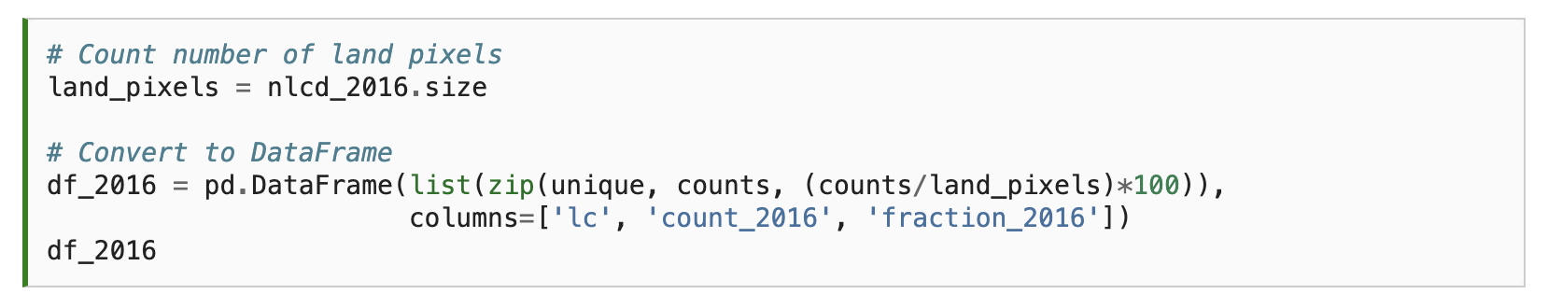
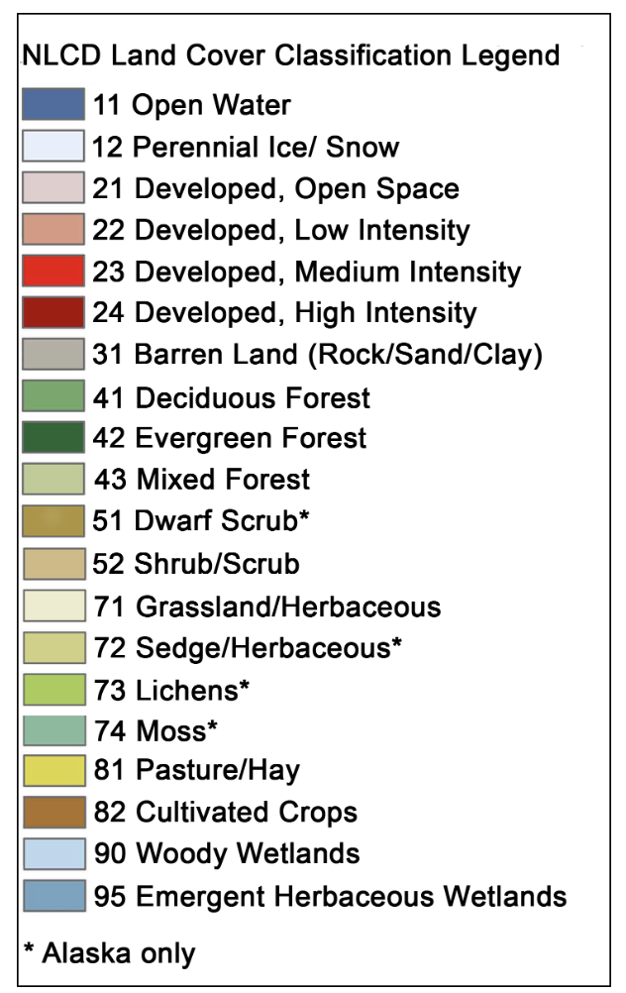

Slide 21
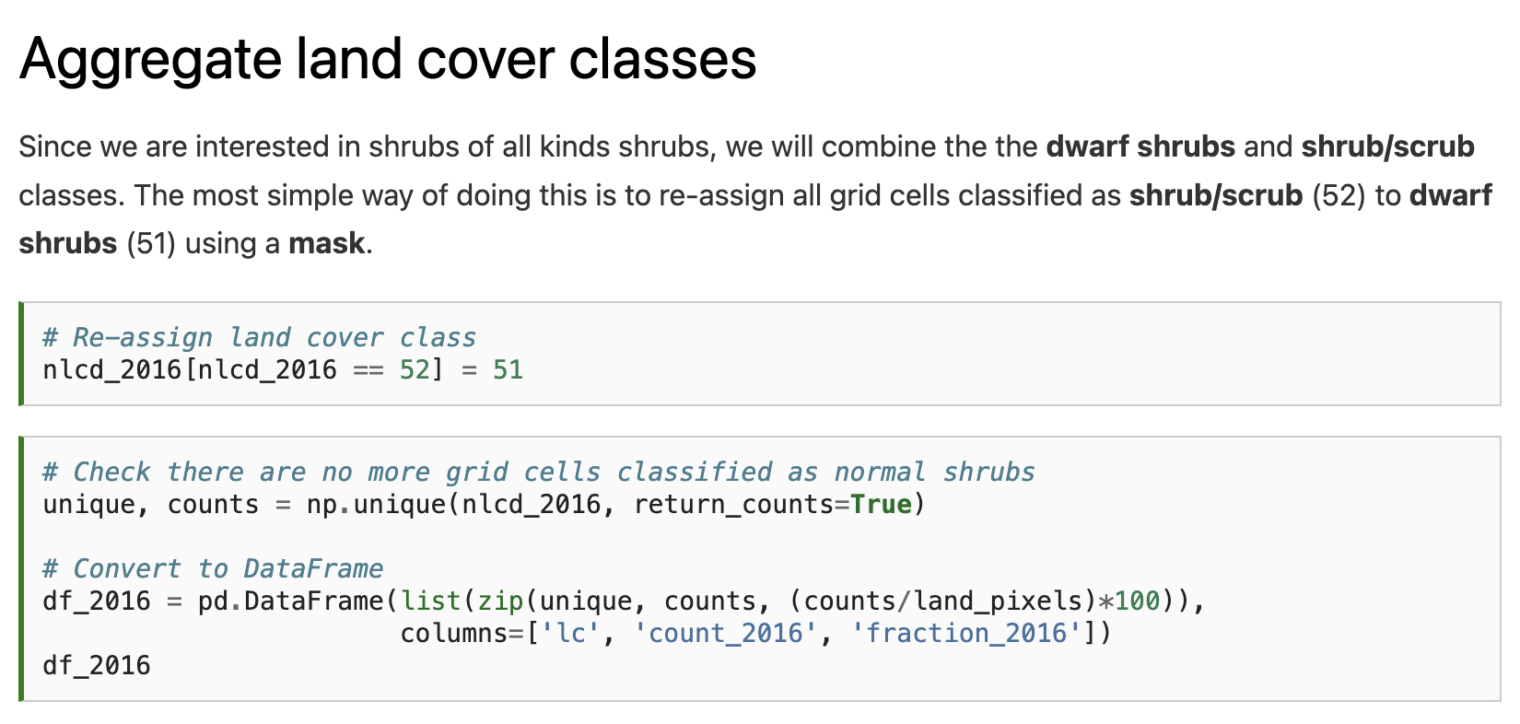

Slide 22
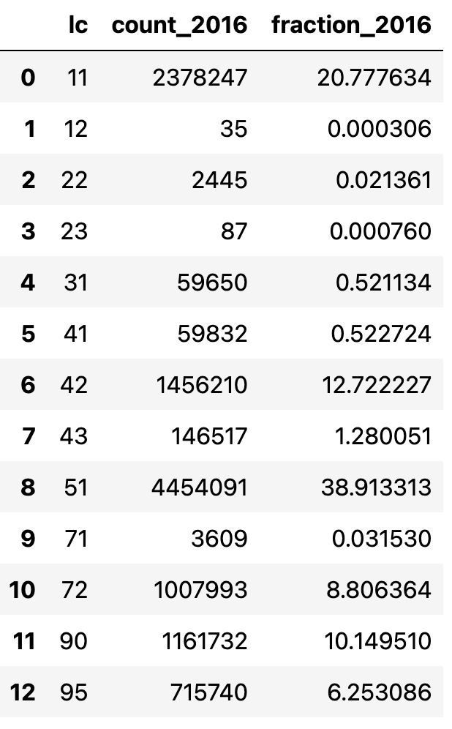

Slide 23
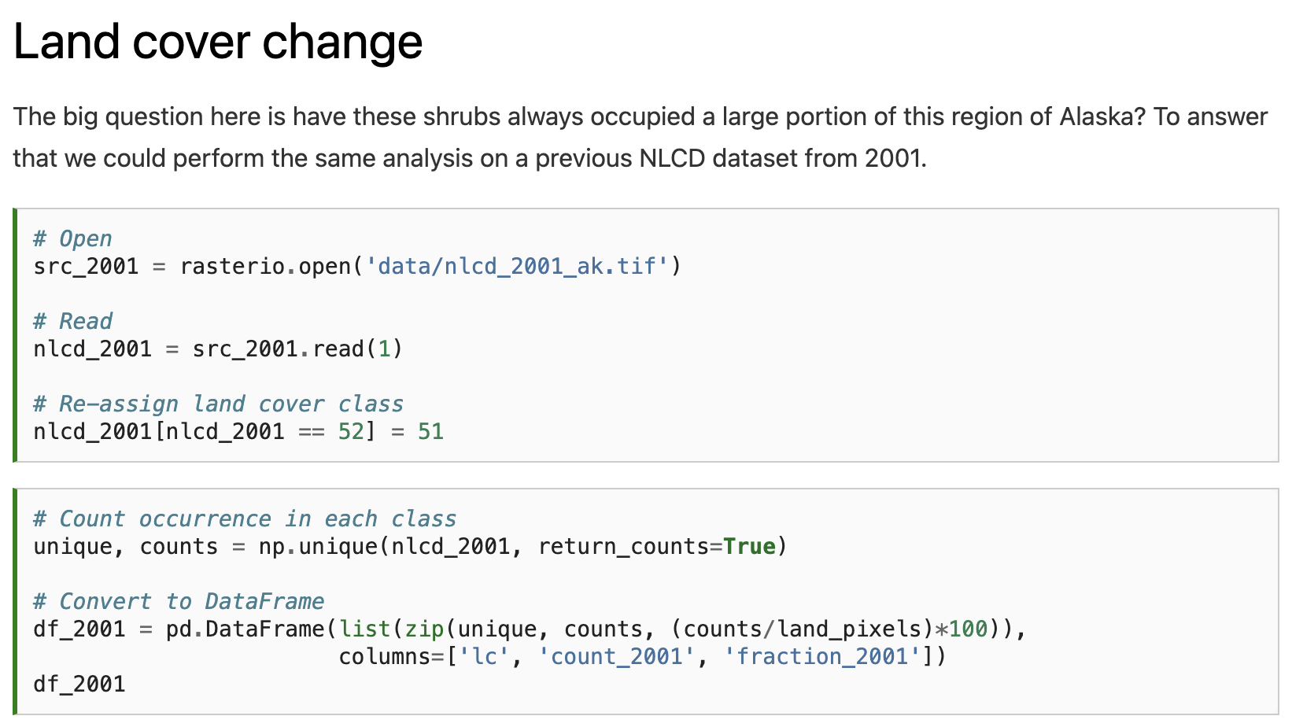
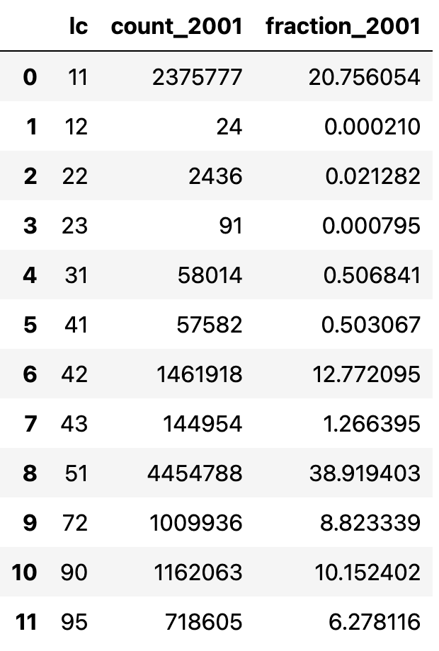

Slide 24
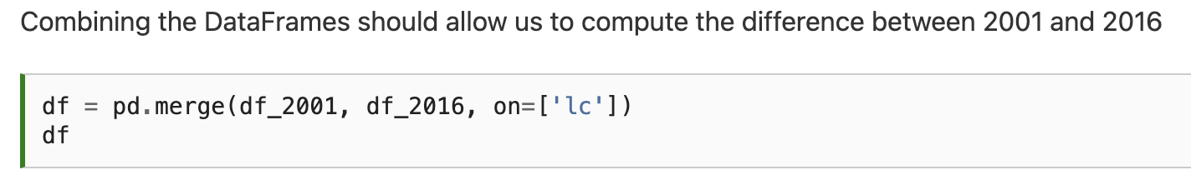
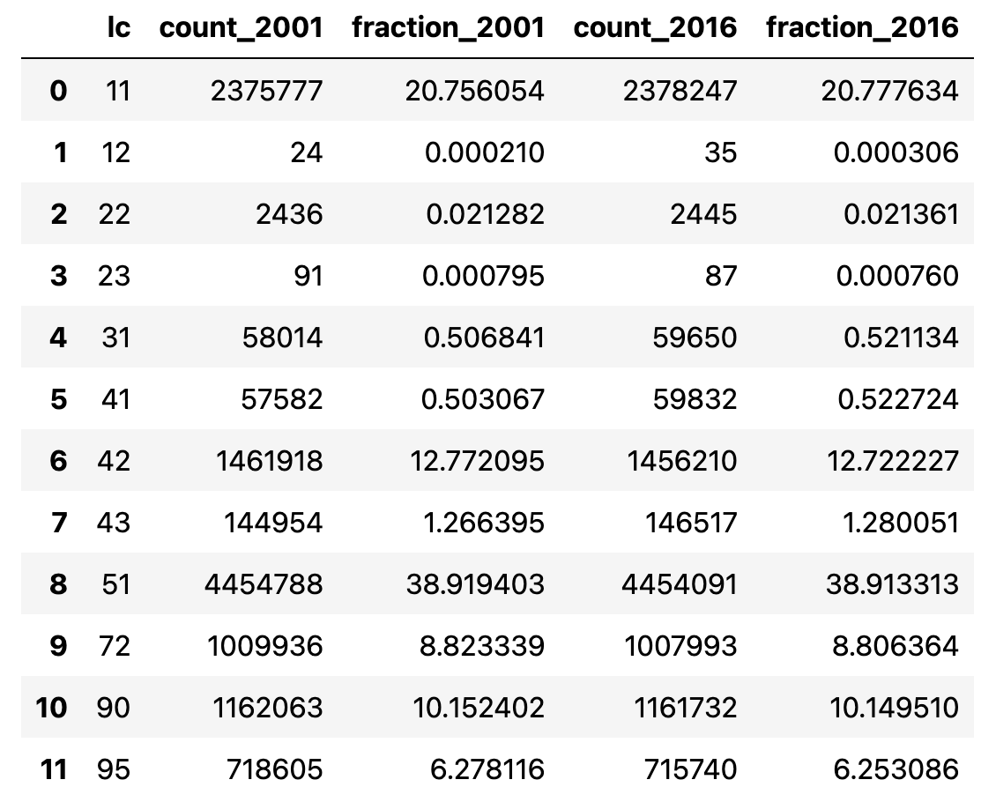

Slide 25
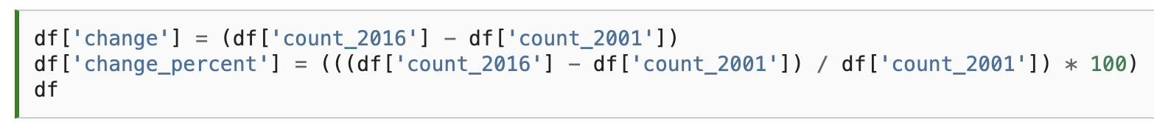

Slide 26
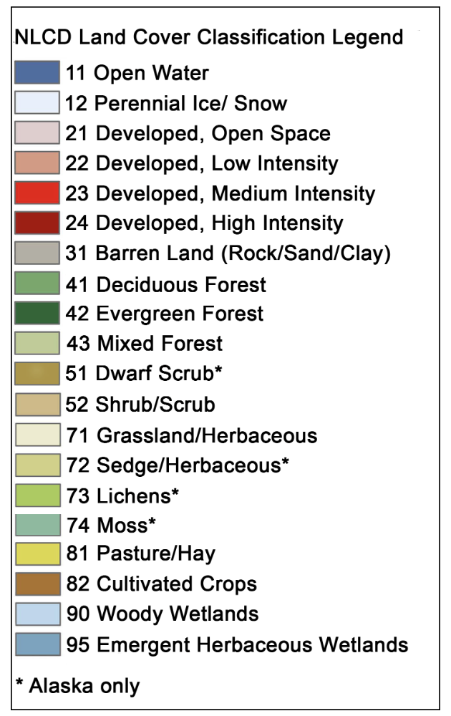
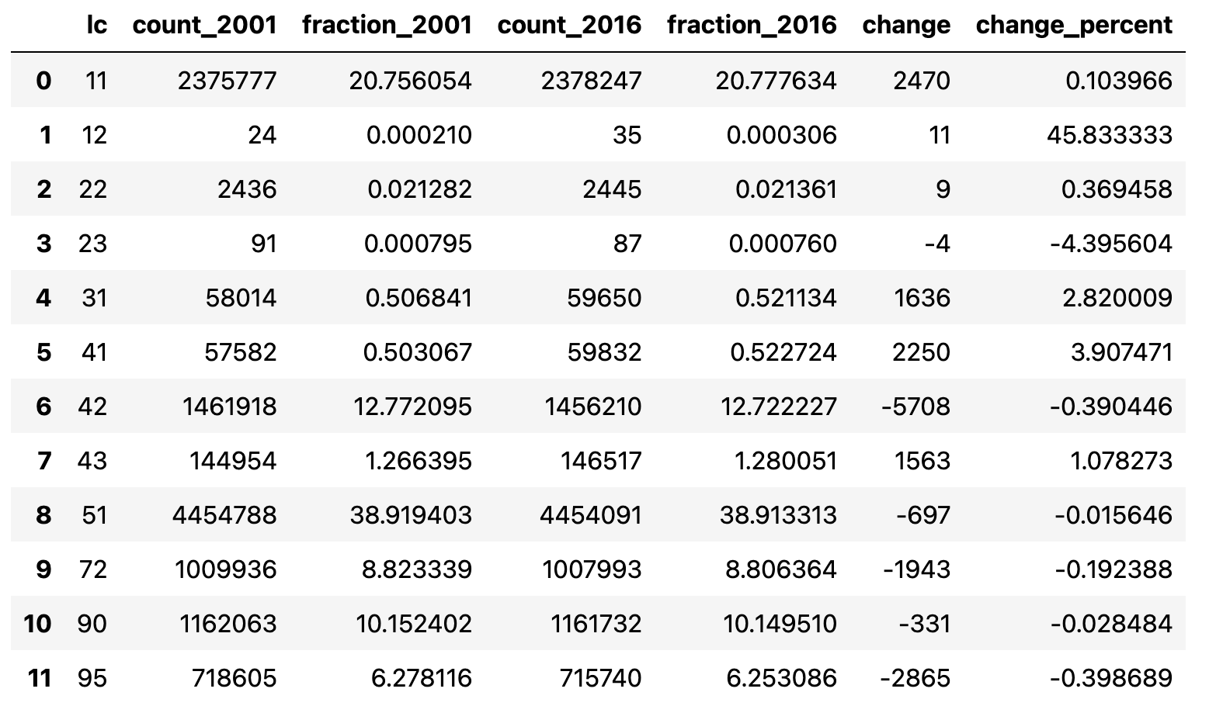
Notes:
Oh dear - the extent of shrubs did not increase between 2001 and 2016. One takeaway from this could be that shrubification is not happening in this region of the Arctic. But the percentage change in shrubs was very small (-0.02%) and could well be smaller than the uncertainty in our land cover product. For example, if just 1% of pixels were incorrectly classified as shrubs in 2001 our result would be insignificant. Other, perhaps more significant changes, that occurred between 2001 and 2016 include an increase in deciduous forest (41) by 3.9%, a decrease in evergreen forest (42) by 0.4%, and a decrease in emergent herbaceous wetlands (95) by 0.4%.

Slide 27
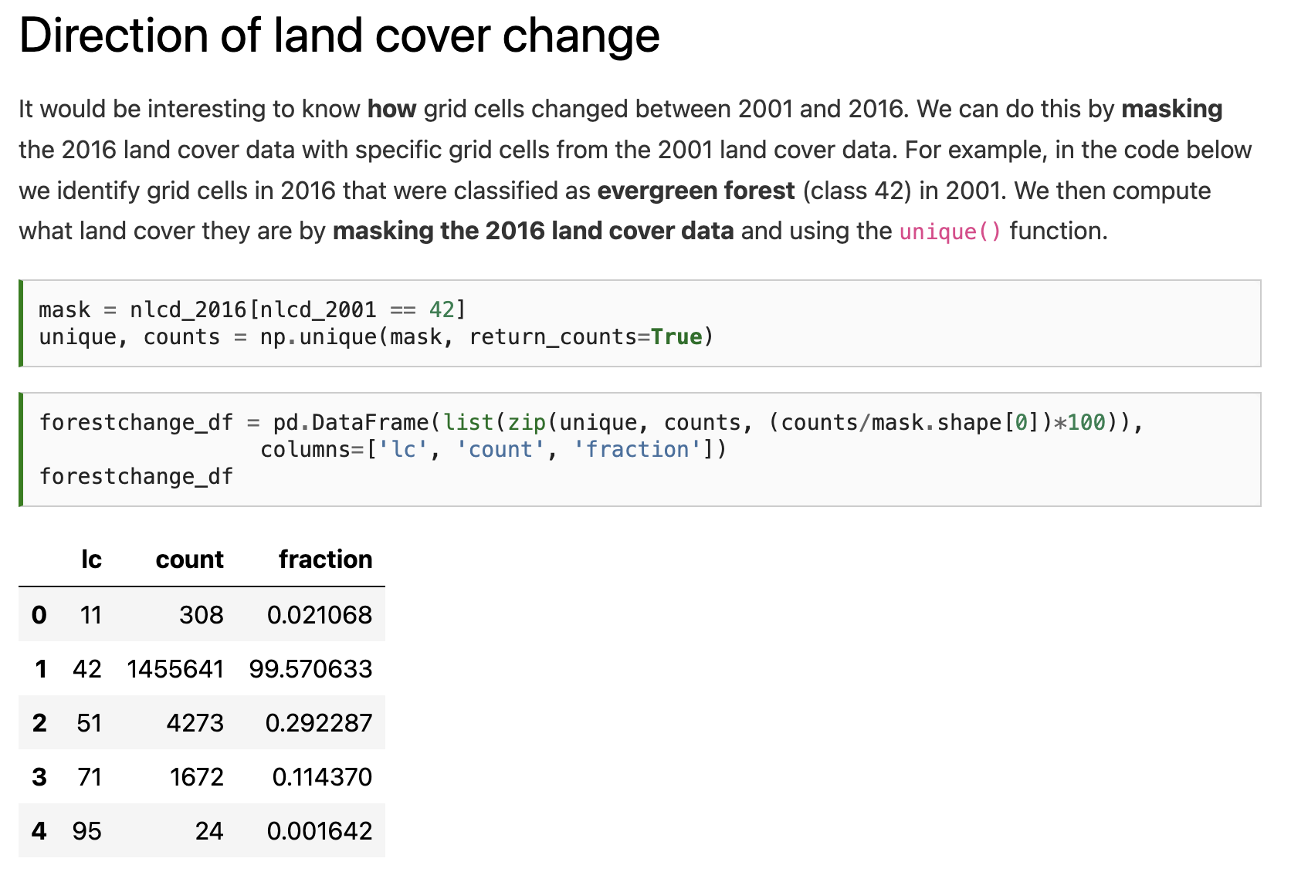

Slide 29
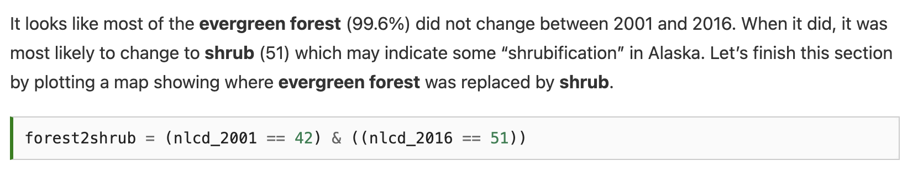

Slide 30
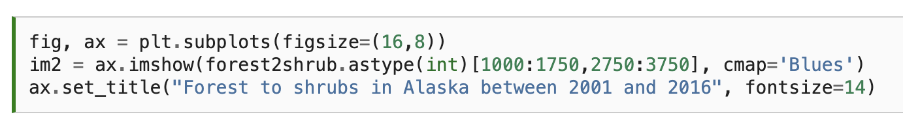
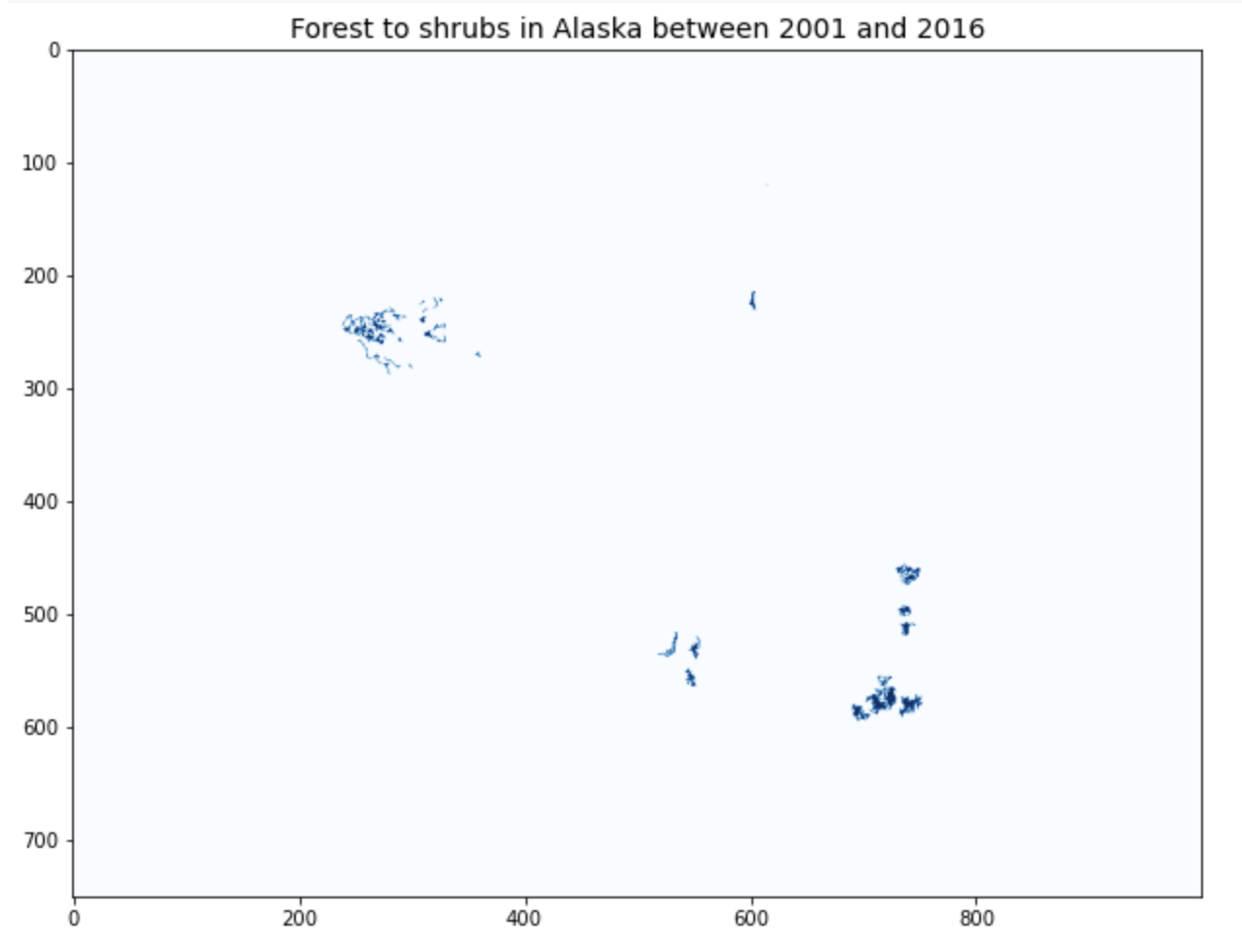

Slide 31
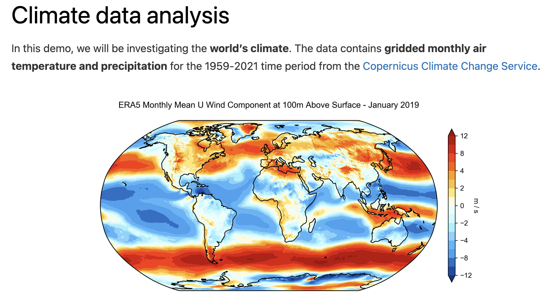

Slide 32
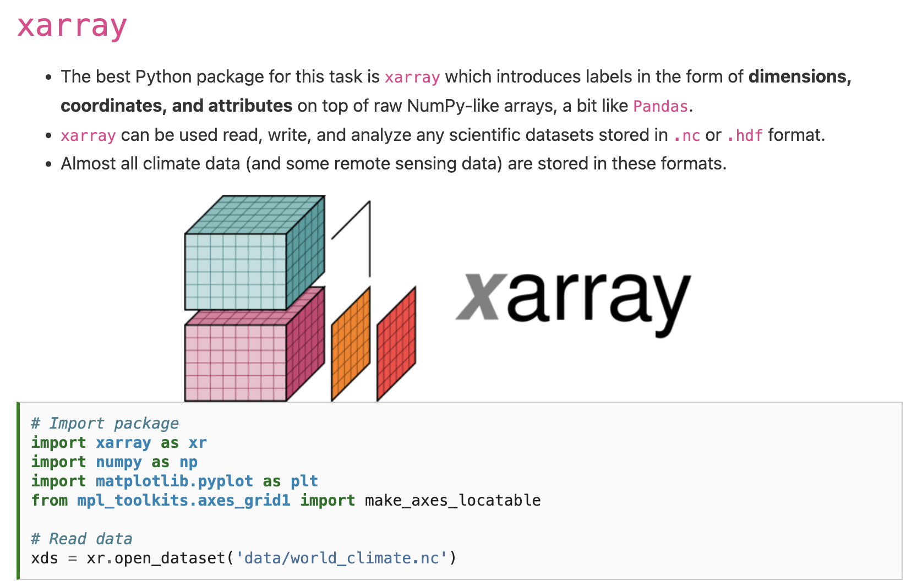

Slide 34
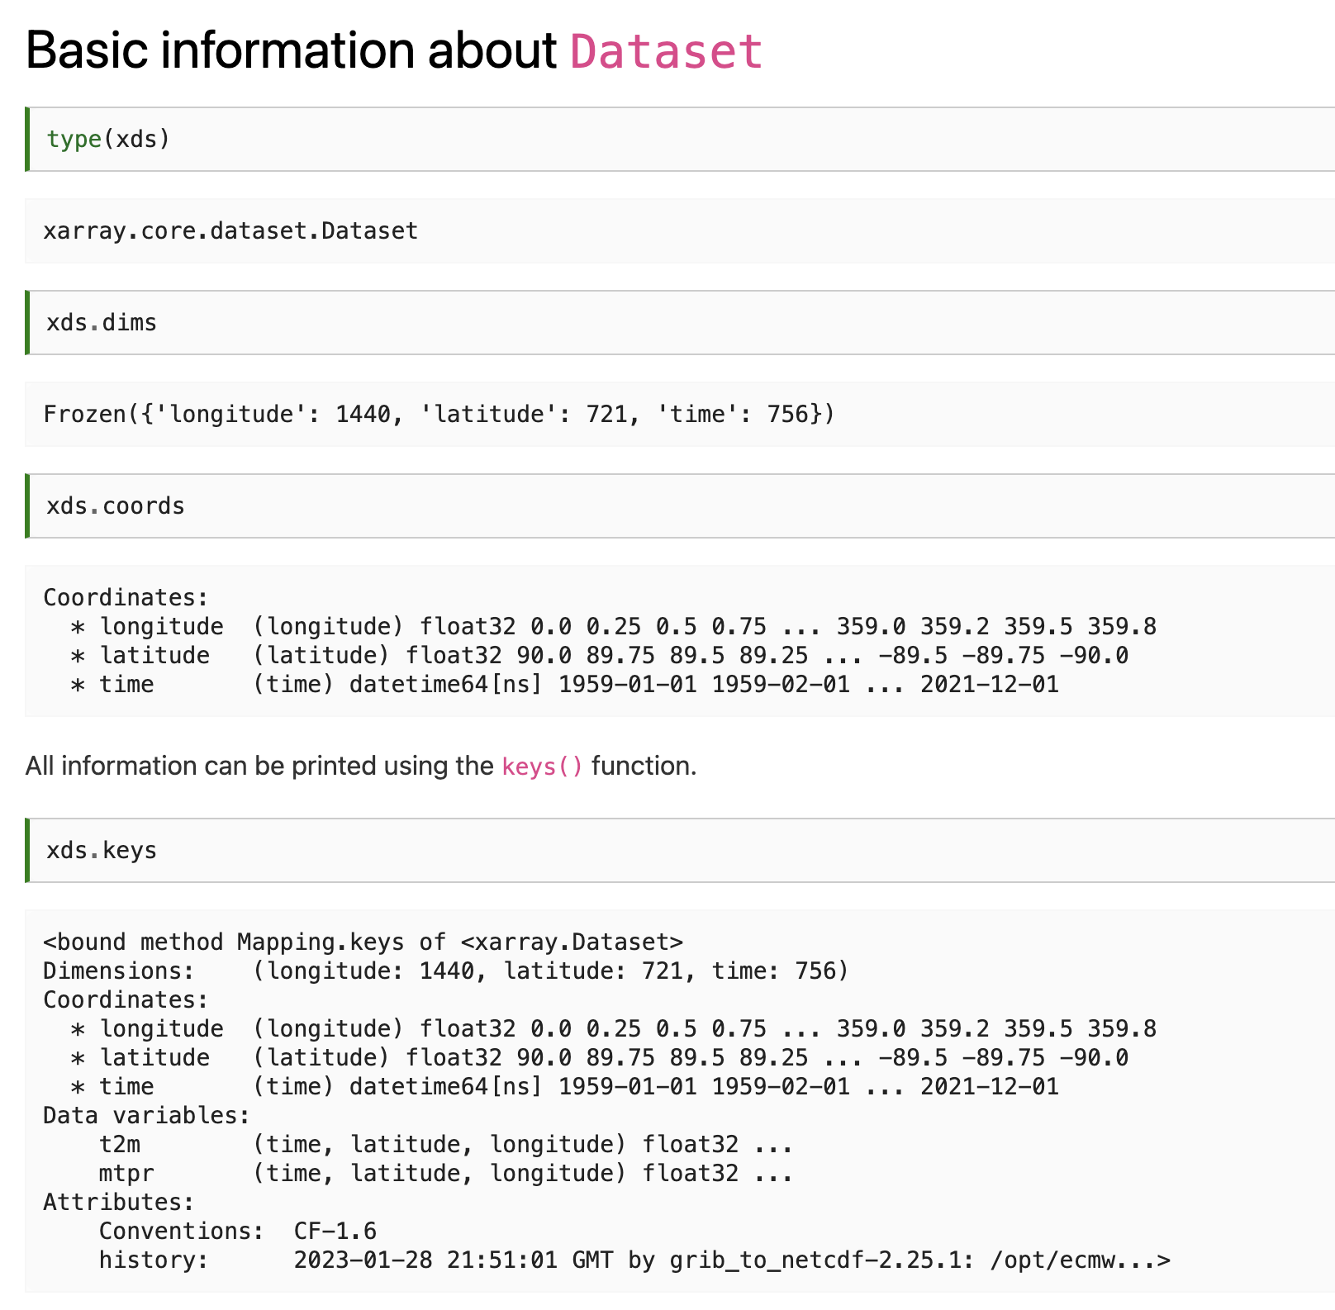

Slide 37
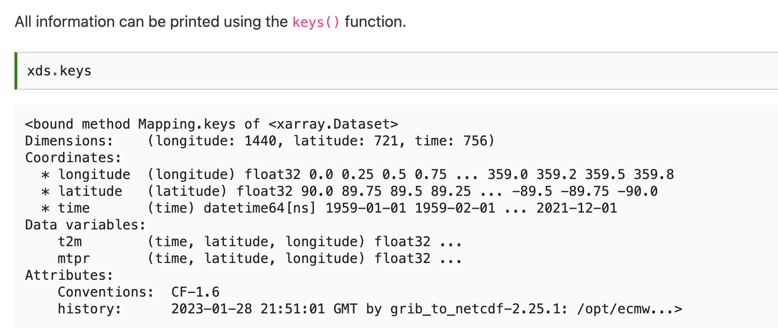
Notes:
t2m stands for 2 m above the surface, the standard height used by temperature sensors. It is a common metric used in climatology but note that it is different from the surface temperature which would be the temperature of the ground surface.

Slide 38
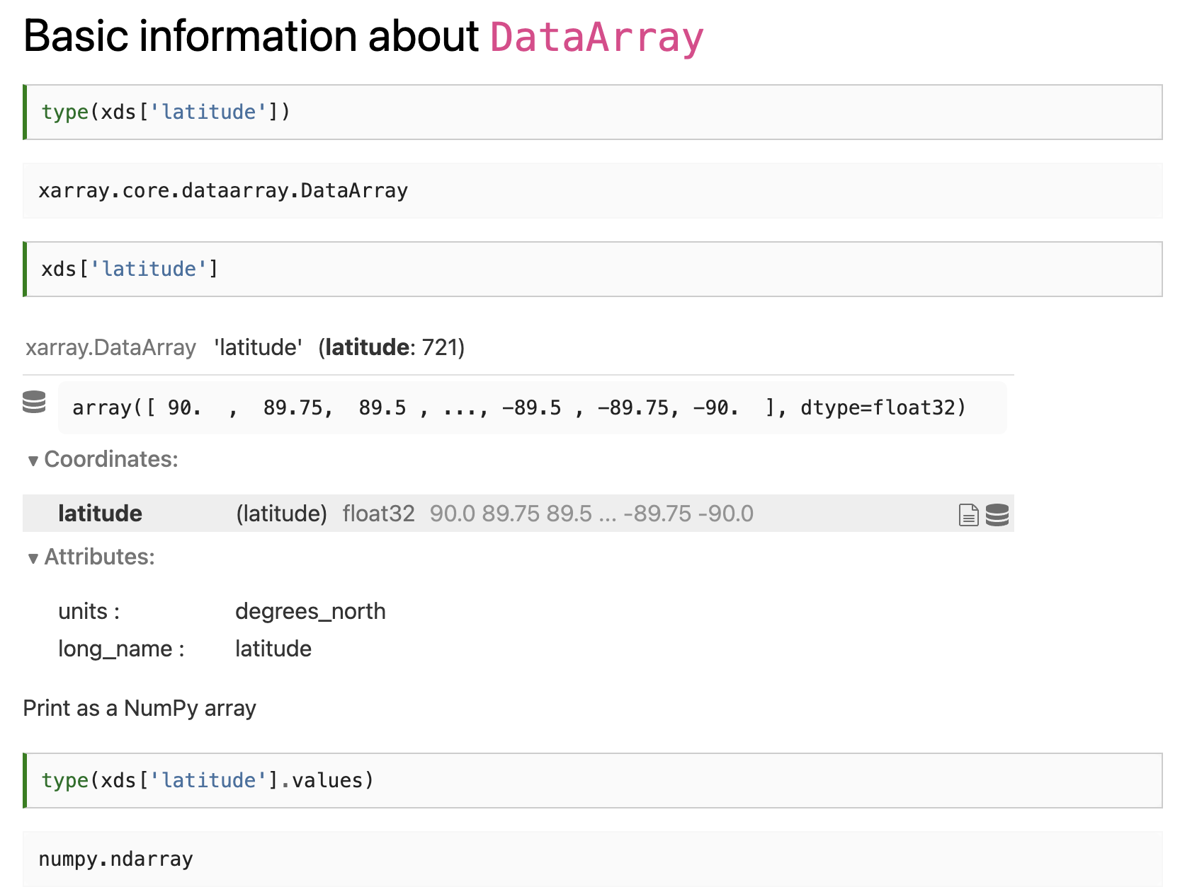
Notes:
\

Slide 39
Notes:
\

Slide 40
Notes:
\

Slide 41
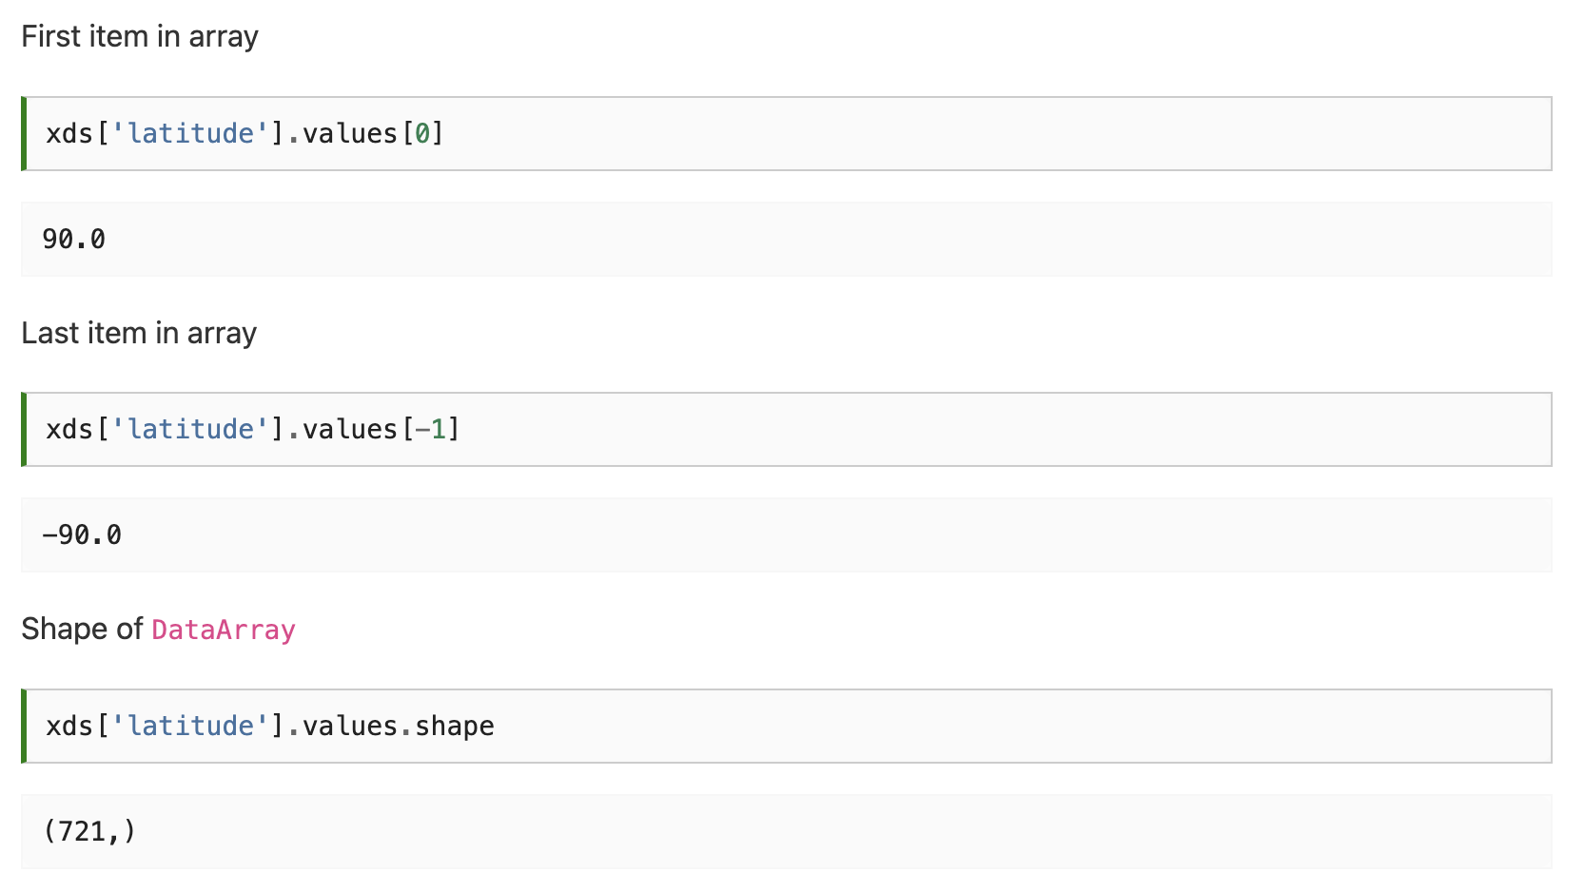
Notes:
\

Slide 42
Notes:
\

Slide 43
Notes:
\

Slide 44
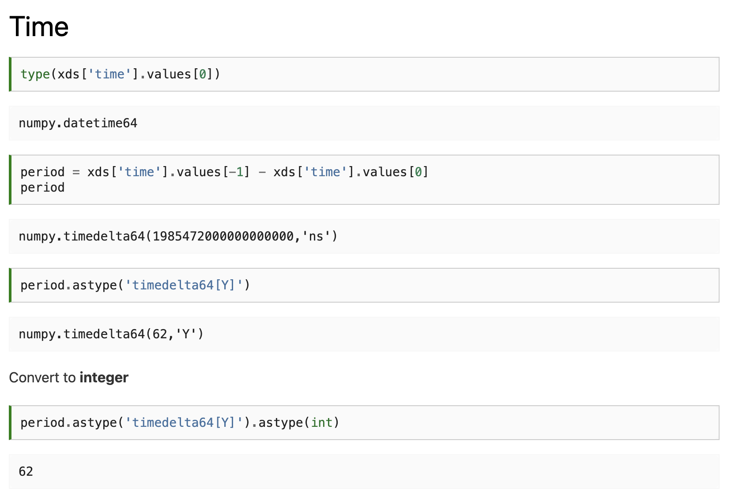
Notes:
\

Slide 45
Notes:
\

Slide 46
Notes:
\

Slide 47
Notes:
\

Slide 48
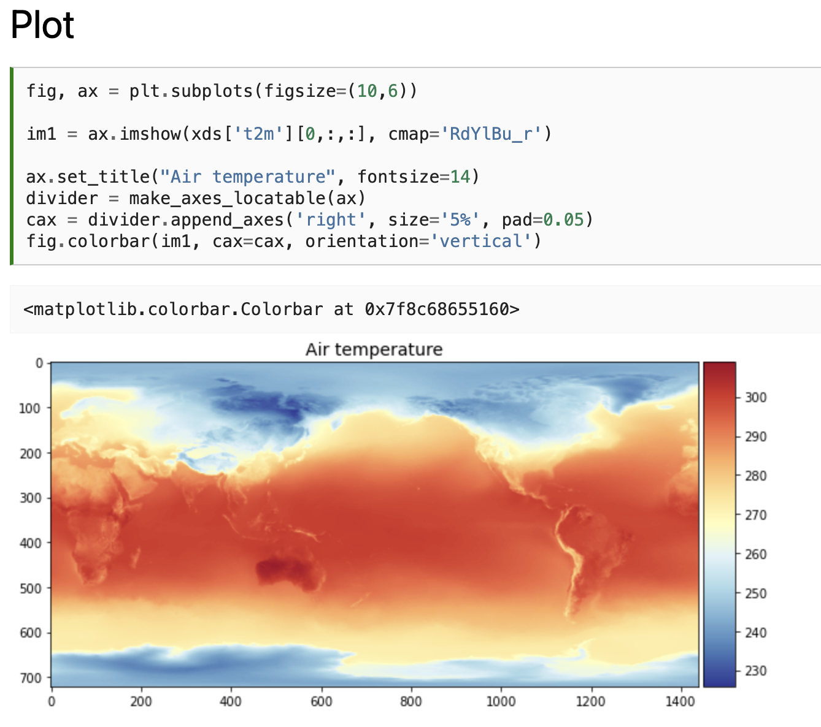
Notes:
\

Slide 49
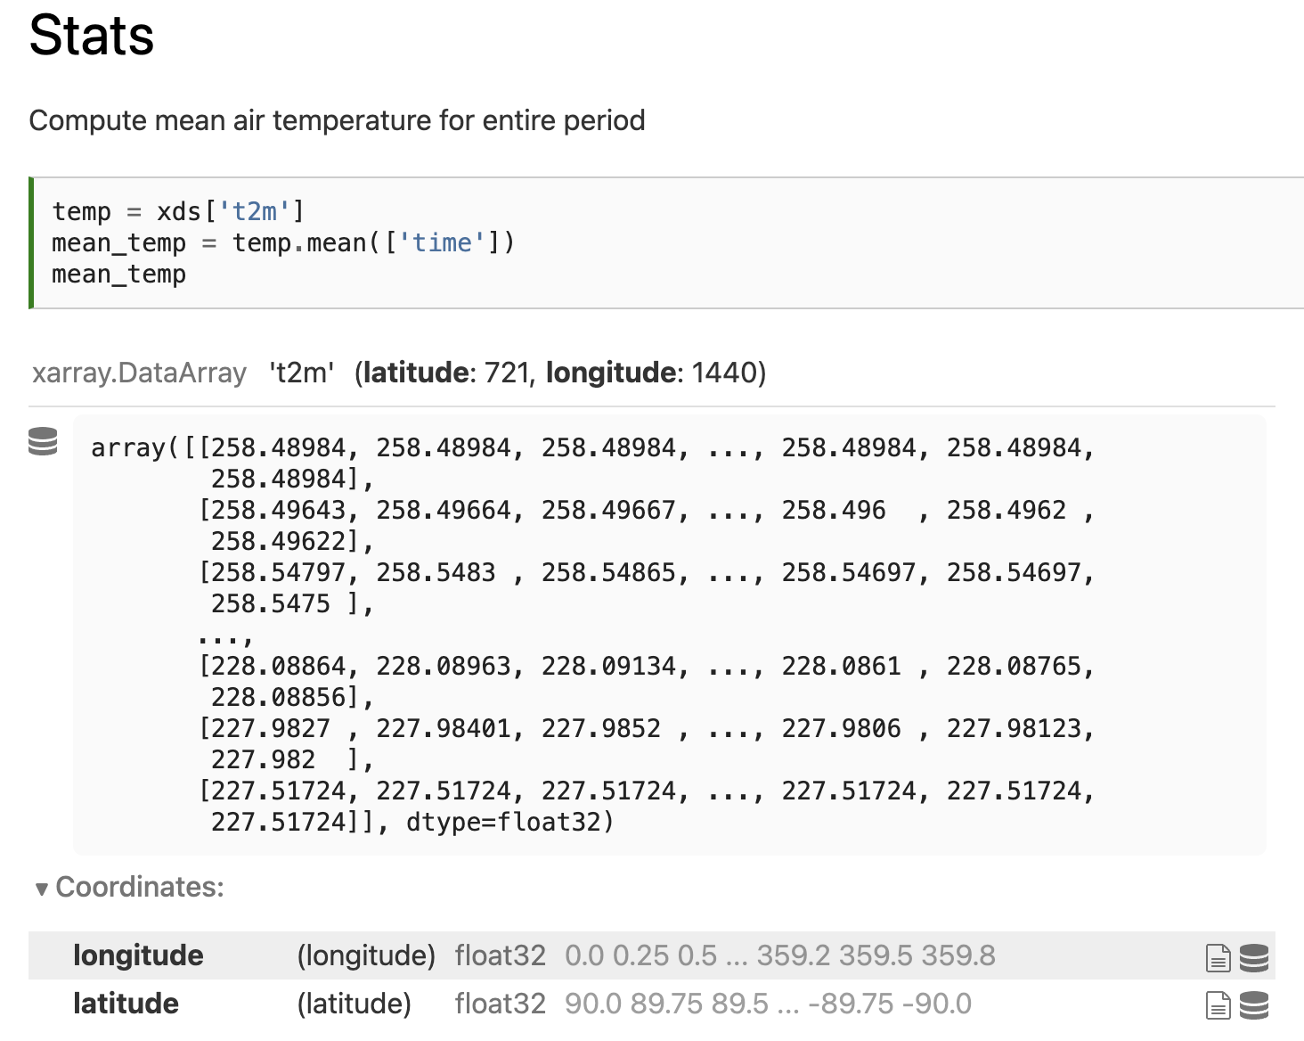
Notes:
\

Slide 50
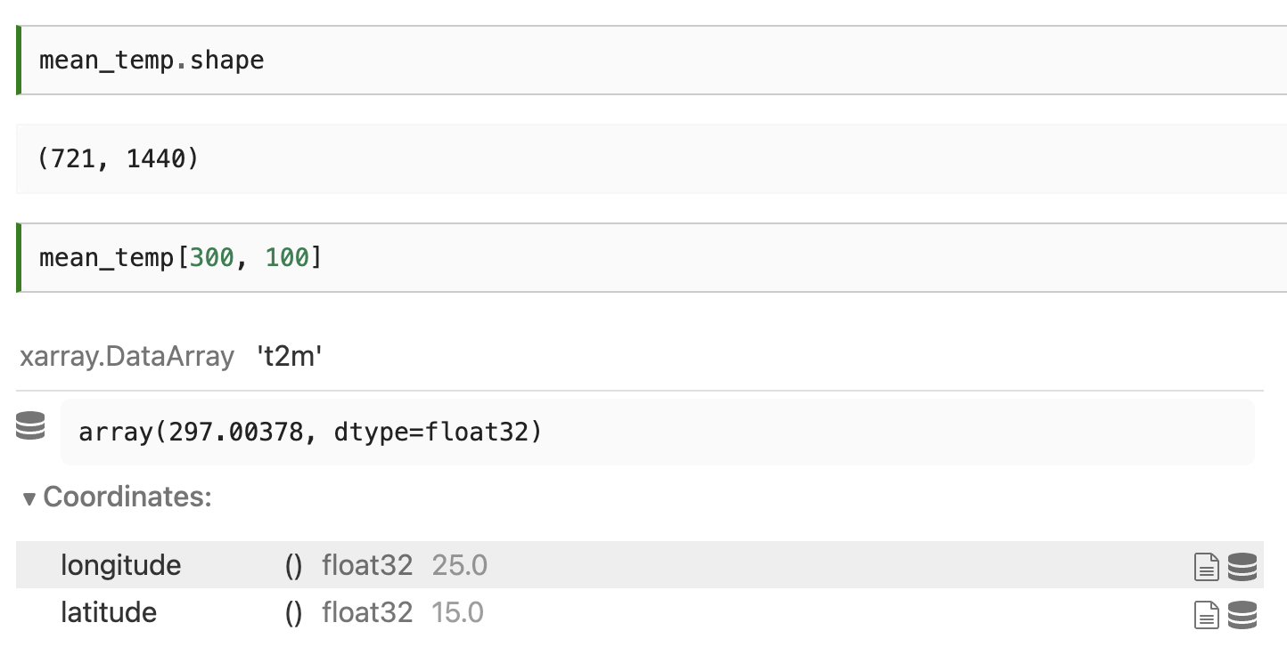
Notes:
\

Slide 51
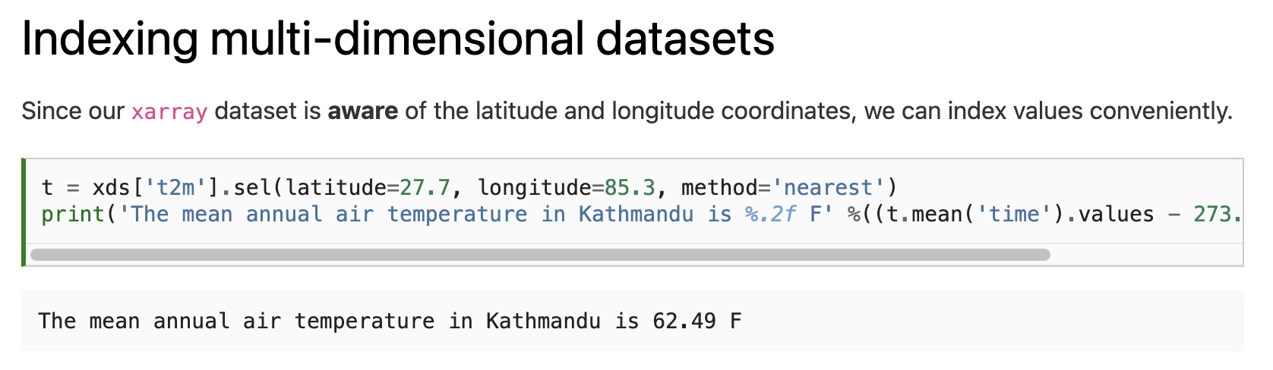
Notes:
\

Slide 52
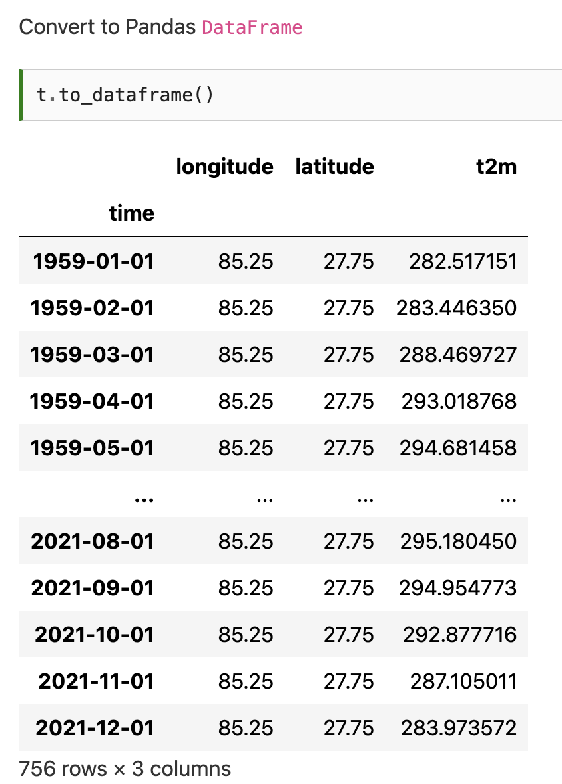
Notes:
\

Slide 53
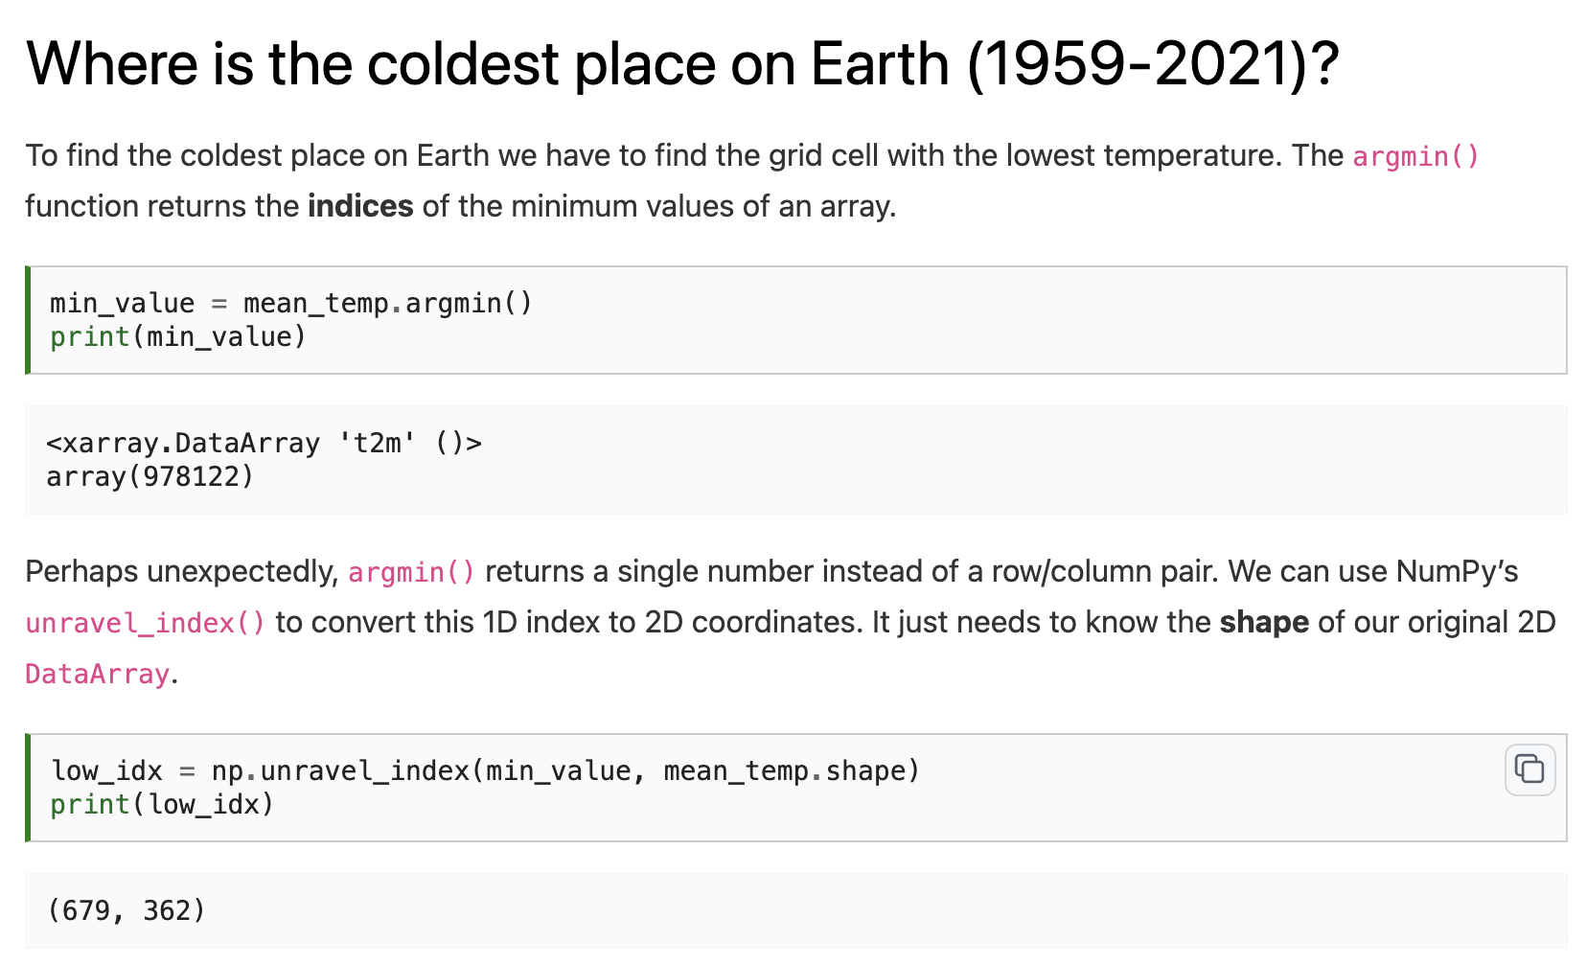
Notes:
\

Slide 54
Notes:
\

Slide 55
Notes:
\

Slide 56
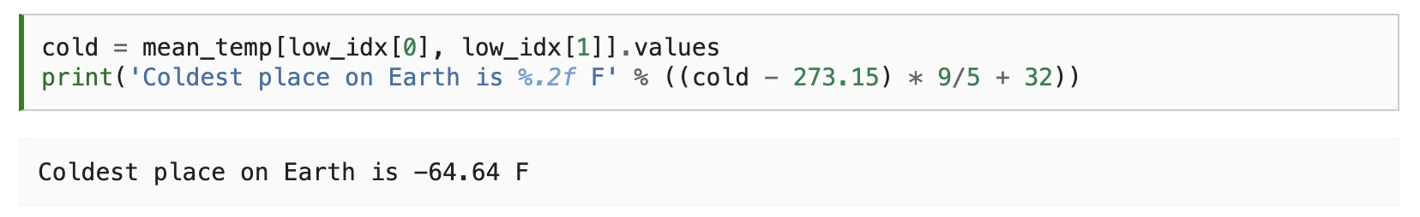

Notes:
\

Slide 57

Notes:
\

Slide 58
Notes:
\

Slide 59

Notes:
\

Slide 60
Notes:
\

Slide 61

Notes:
\

Slide 62
Notes:
\

Slide 63


Slide 64
Thursday: Previous final projects
Email: jryan4@uoregon.edu
Office: 163A Condon Hall
Office hours: Monday 15:00-16:00 and Tuesday 14:00-15:00

